Slide 1
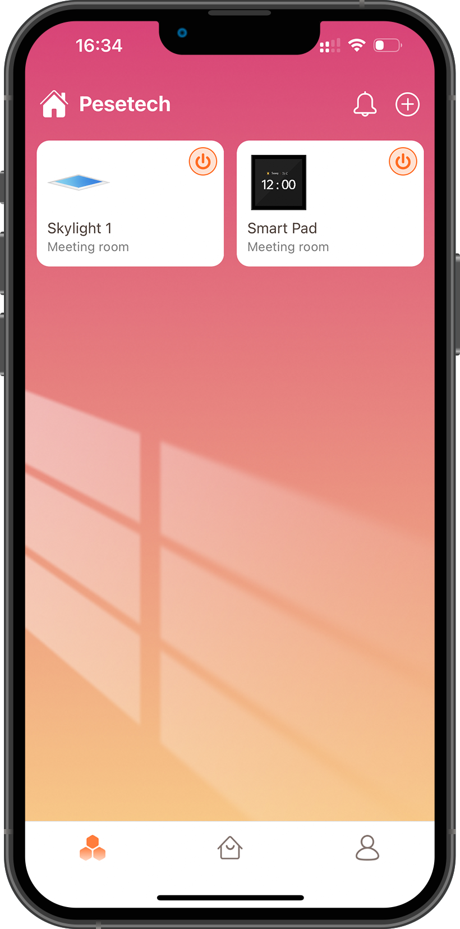
Pesetech
App manual
Skylight Function Introduction
June 2023 V1.0 IOS
Do joyous photon

Slide 2
/MANUAL
01
02
03
04
Register account
Download
Register
Add Skylight
indicator light
add device
add failed & solution
Reset Skylight
create group
Binding Dimmer
Three types of dimmers
add dimmer & bind Skylight
dimmer reset
Product function
Skylight

Slide 3
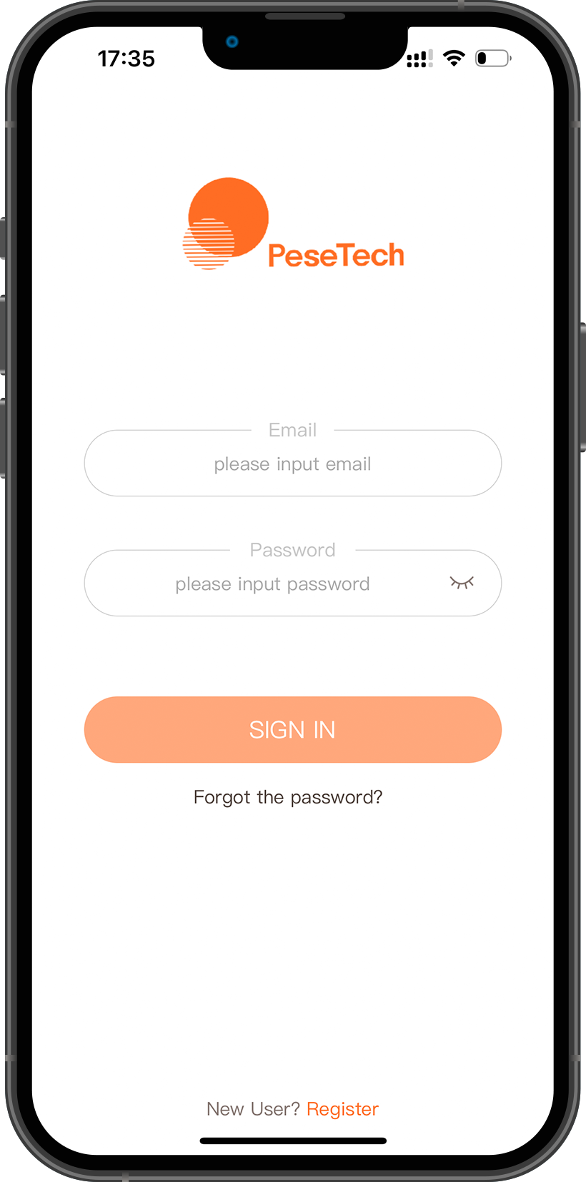
PART ONE
LO
GO
Register account
请输入公司名称
The company name

Slide 4
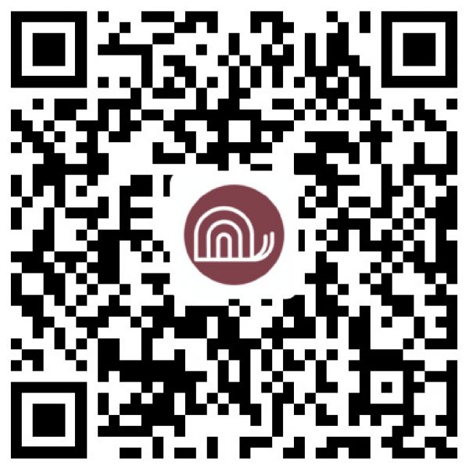
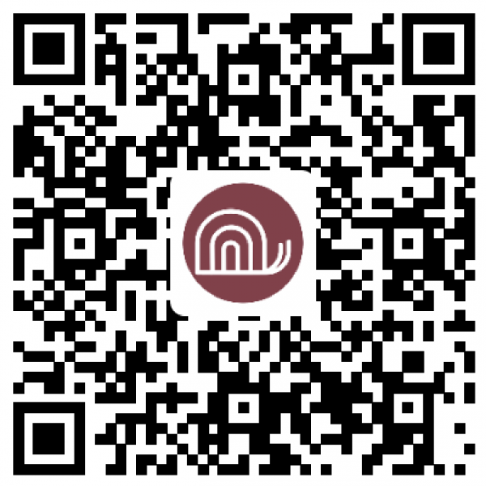
Register account
APP
download
Scan the code to download, or search for "Pesetech"
in the Apple App Store and Google Play to download.
IOS
Android

Slide 5
Register account
APP
Register an account
Select a server.
Enter registered email
Enter the property name, account password and country

Slide 6
PART TWO
LO
GO
Add Skylight
请输入公司名称
The company name

Slide 7
Add Skylight
Status indication
Skylight has three status indicators: "factory setting", "network connection" and "activation successful".
Factory settings
Before the sunroof is activated, the blue and yellow lights will flash alternately and rapidly each time the power is turned on.
Activation Successful
When Skylight is flashing yellow light and blue light alternately at a slow speed, it means that Skylight has connected to the server and has received the data returned by the server.
Network Connection
When Skylight is in white light gradient, it means that Skylight is connecting to WIFI network.

Slide 8
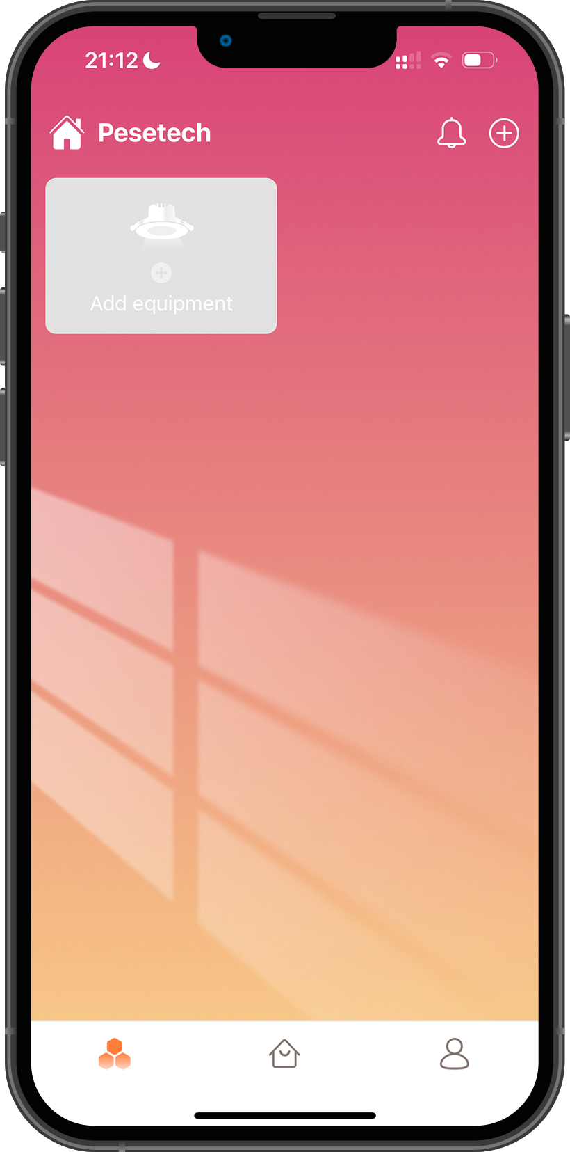
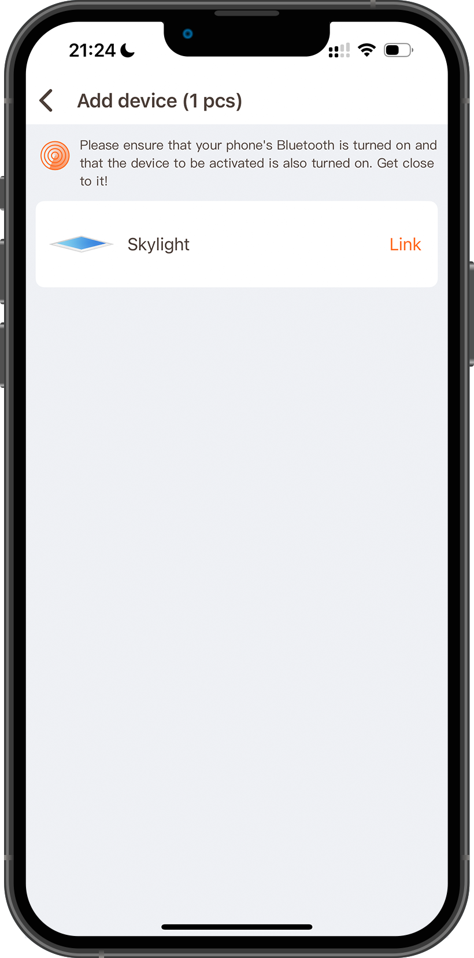
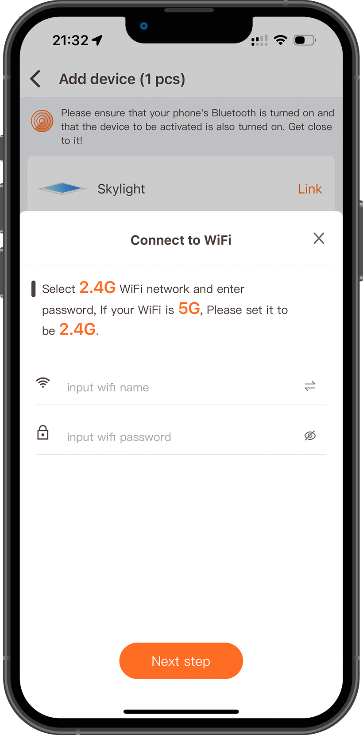
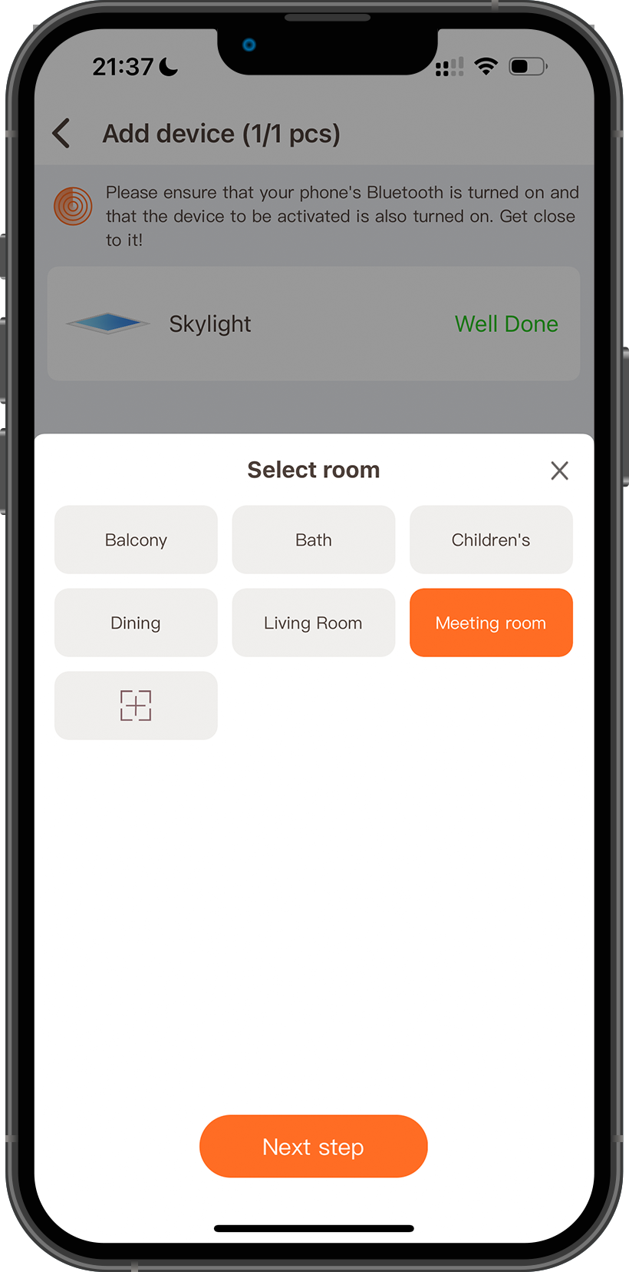
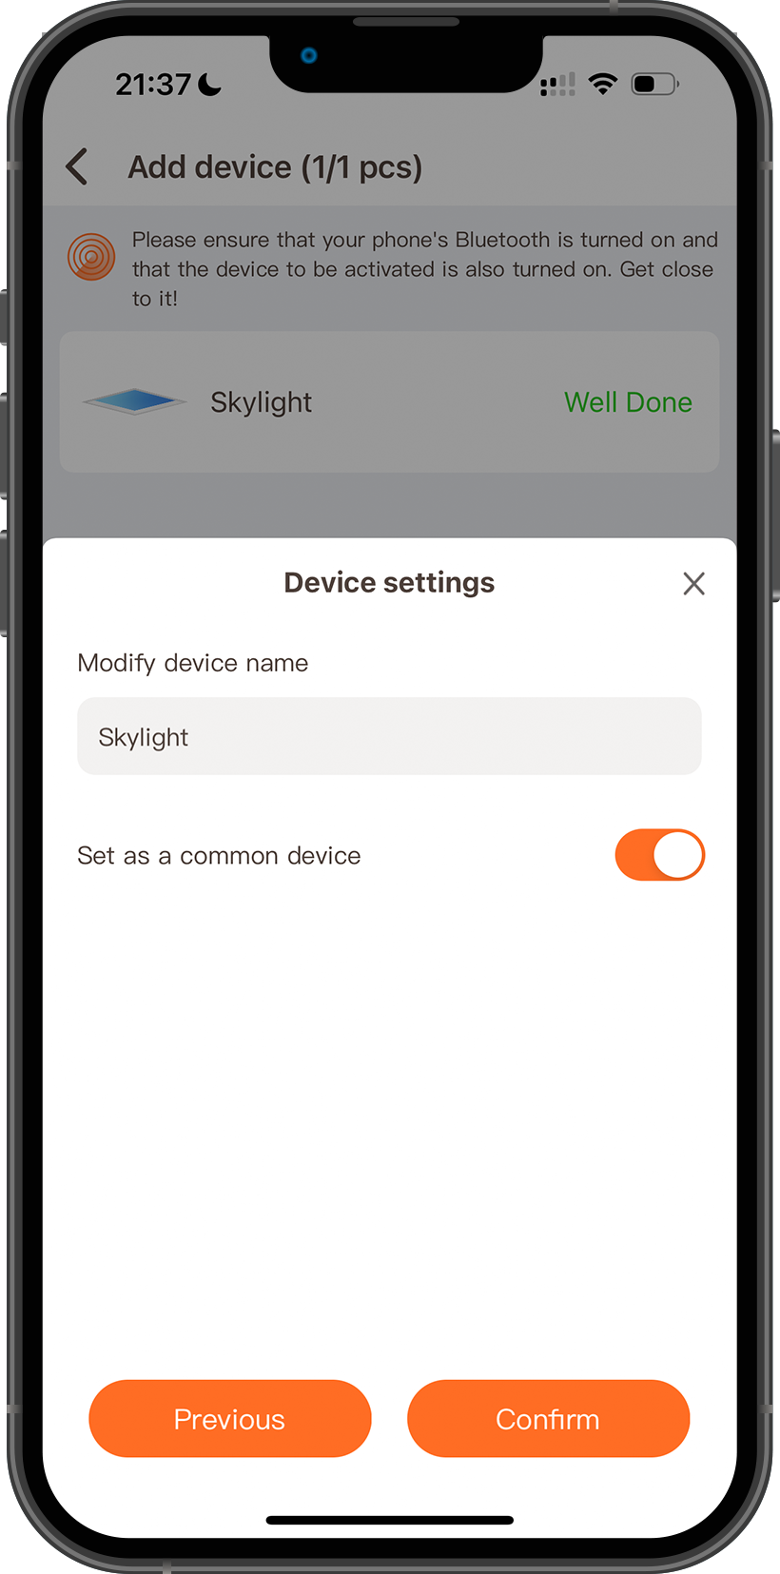
Add Skylight
1
2
3
4
5
Click + to search for devices
Click Link to connect the device
Enter the 2.4Ghz WIFI account and password to connect the device to the WIFI network.
Add devices to the room for better management and control of Skylight. You can also create rooms yourself.
Give Skylight a name, it is convenient for you to manage and control Skylight.

Slide 9
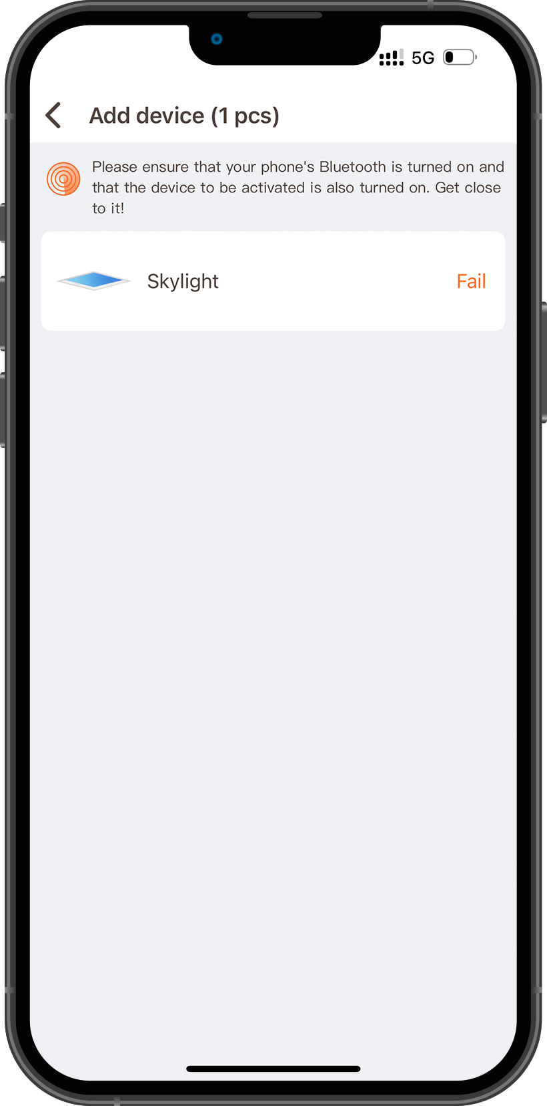
Add Skylight
Activation fails
When the APP shows activation failure, turn off the power of Skylight for 5 minutes. Then power on again.
01
Skylight flashes yellow light and blue light alternately quickly, which means that Skylight is not connected to the WIFI network.
Solution
Please confirm that the connected WIFI network is a 2.4Ghz signal, whether the account password is correct, and whether Skylight is in a place where the WIFI signal is weak.

Slide 10
Add Skylight
Activation fails
When the APP shows activation failure, turn off the power of Skylight for 5 minutes. Then power on again.
02
When Skylight is turned on again, Skylight will gradually change from white to bright to dark repeatedly!This means Skylight has connected to WIFI. But not connected to the server.
Solution
When this happens, after confirming that the WIFI network is smooth, restore Skylight to factory settings and reconnect to WIFI.

Slide 11
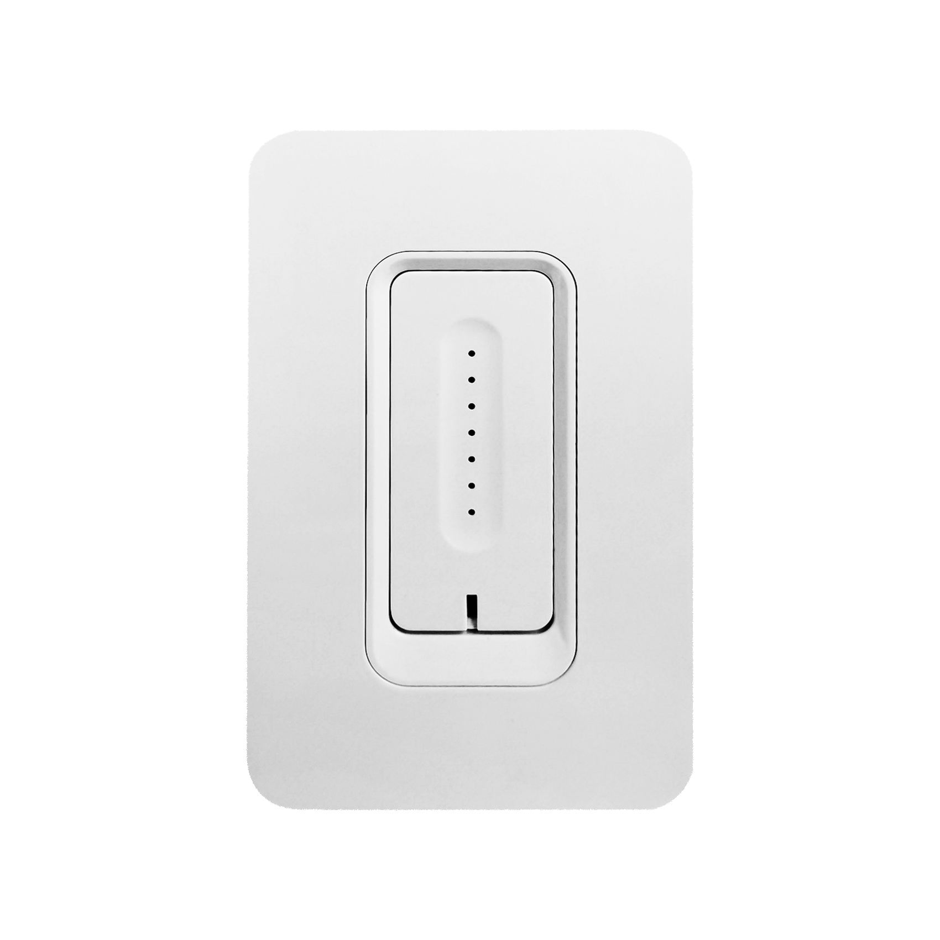
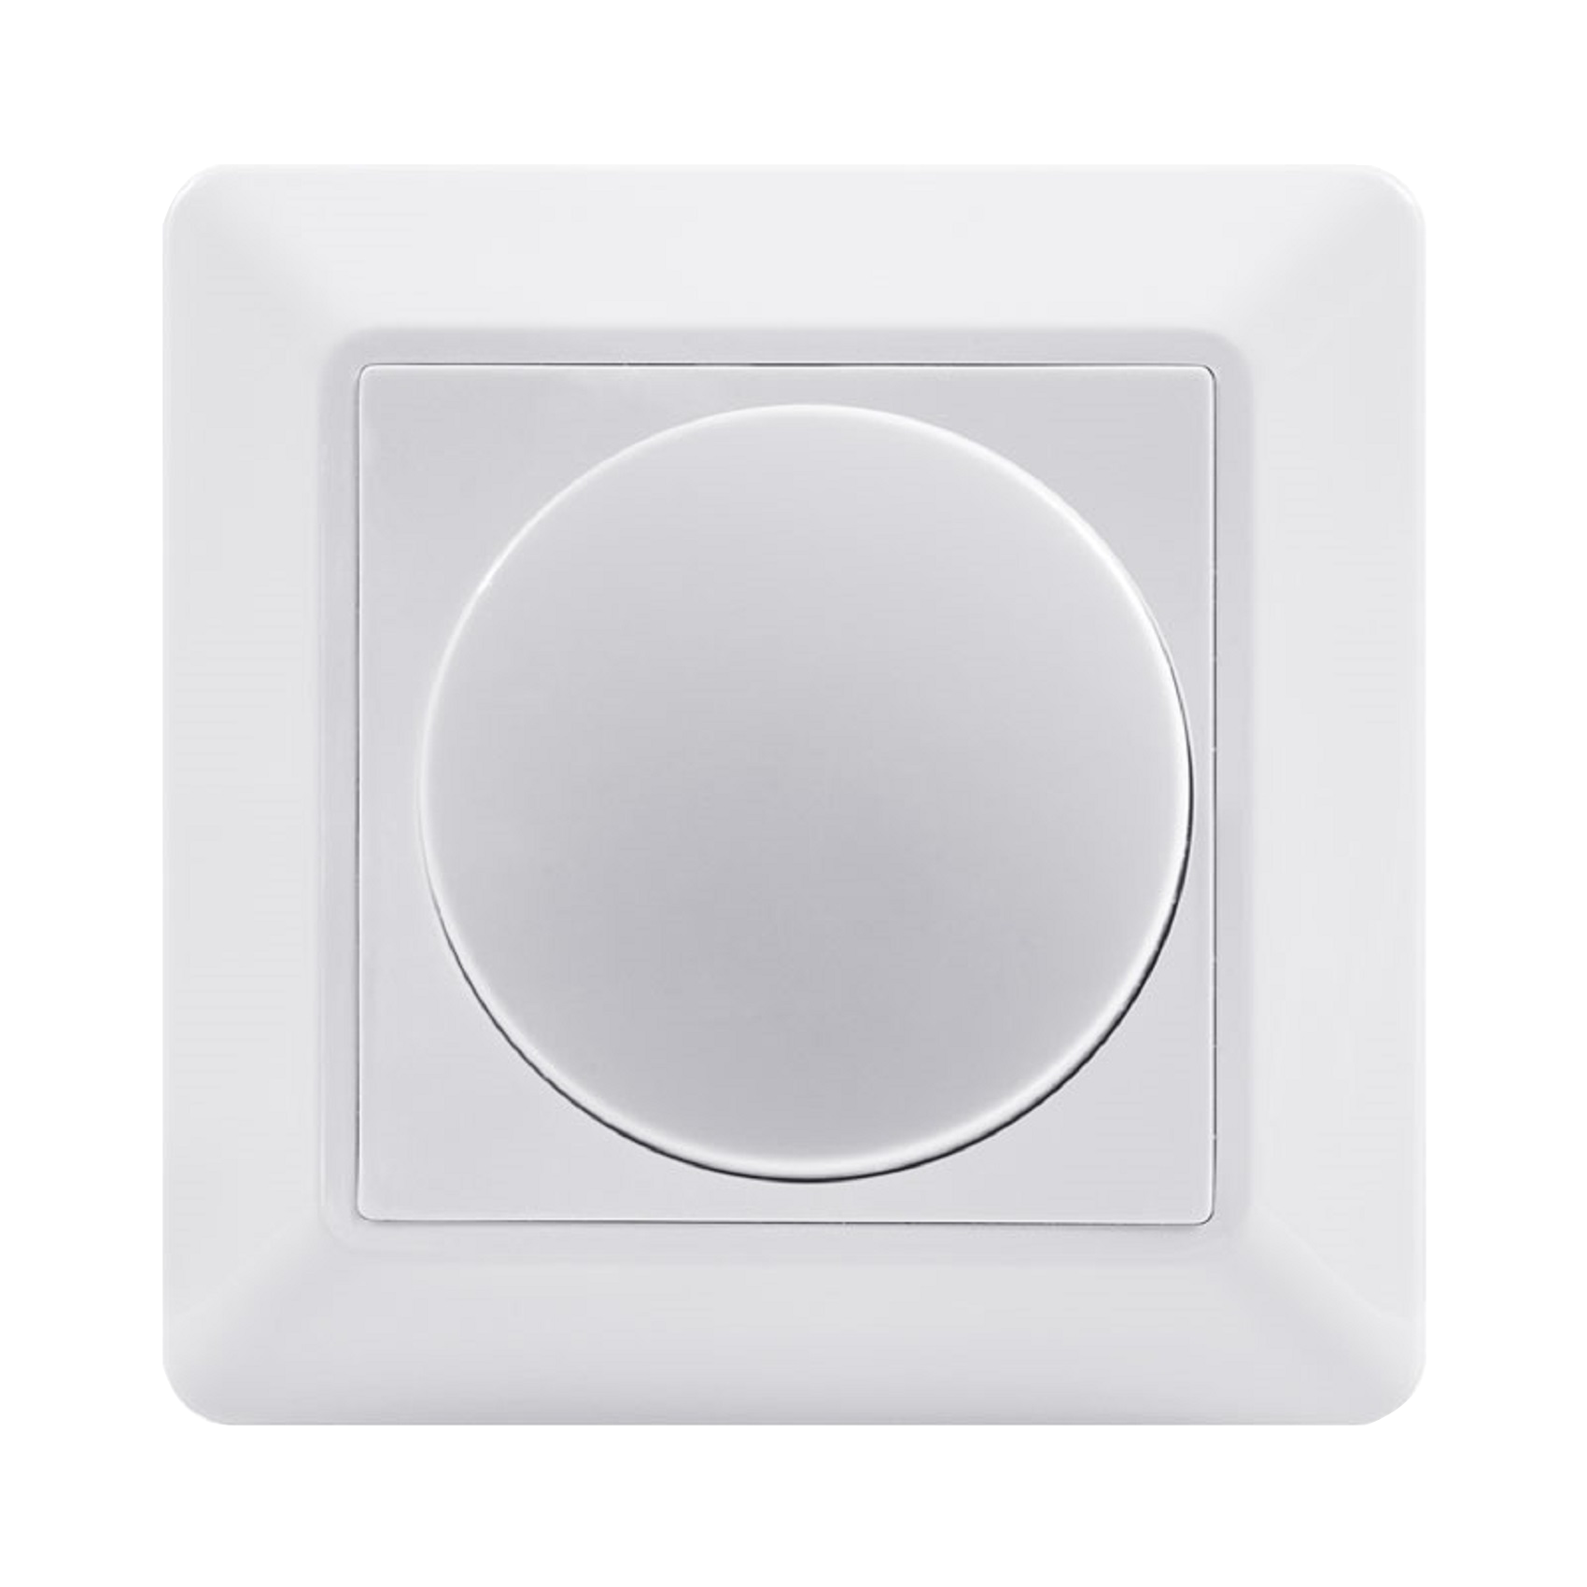
Add Skylight
How to reset Skylight
Different dimmers are connected, or the reset method is different when no dimmer is connected.
Scan Dimmer
If Skylight is connected to Scan Dimmer, turn on the dimmer knob, use the DIP switch inside the dimmer to reset Skylight, the reset method is to turn off the light for 10S, turn on the light for 1S, then turn off the light for 10S, turn on the light for 1S, After repeating 5 times, if you see Skylight flashing yellow light and blue light alternately quickly, it means that Skylight reset is successful.
Touch Dimmer
If the Skylight is connected to the Toch Dimmer, the way to reset the Skylight is to press the Touch Dimmer's power button 5 times continuously. Touch Dimmer will automatically execute the command to reset Skylight, that is, turn off Skylight10S, turn on Skylight1S, then turn off Skylight10S again, turn on the light for 1 second... repeat 5 times.
Normal Switch
When the Skylight is connected to an ordinary switch, the reset method is to turn off the light for 10 seconds, turn on the light for 1 second, then turn off the light for 10 seconds, turn on the light for 1 second, and repeat 5 times to reset the Skylight.

Slide 12
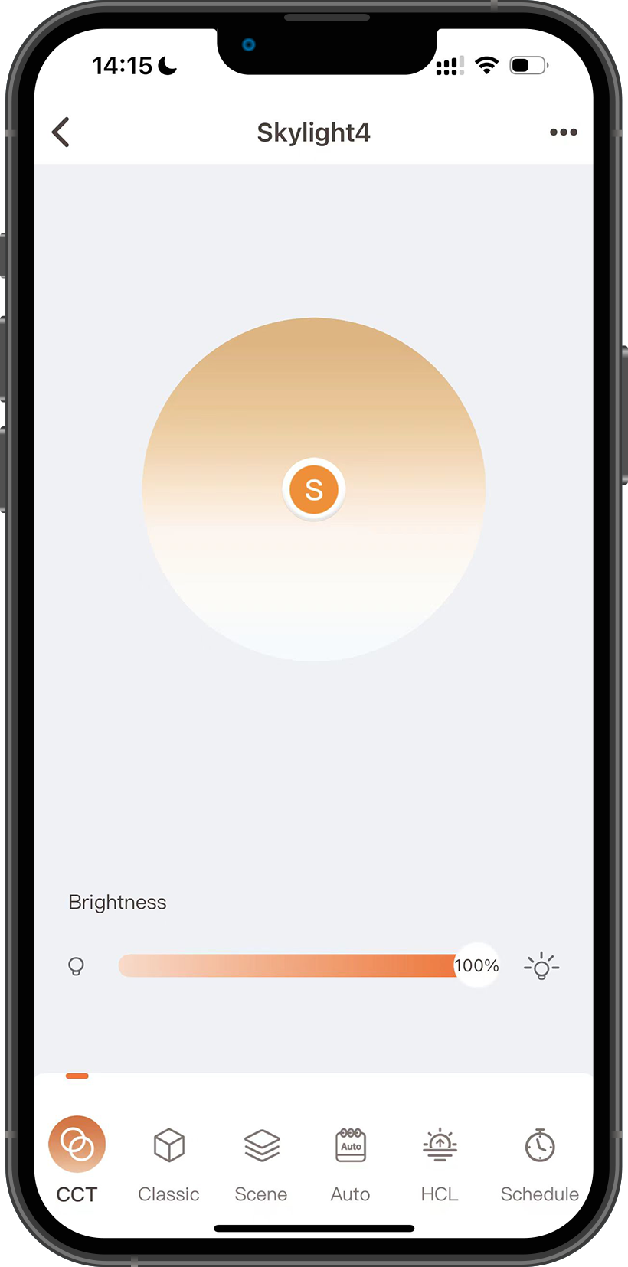
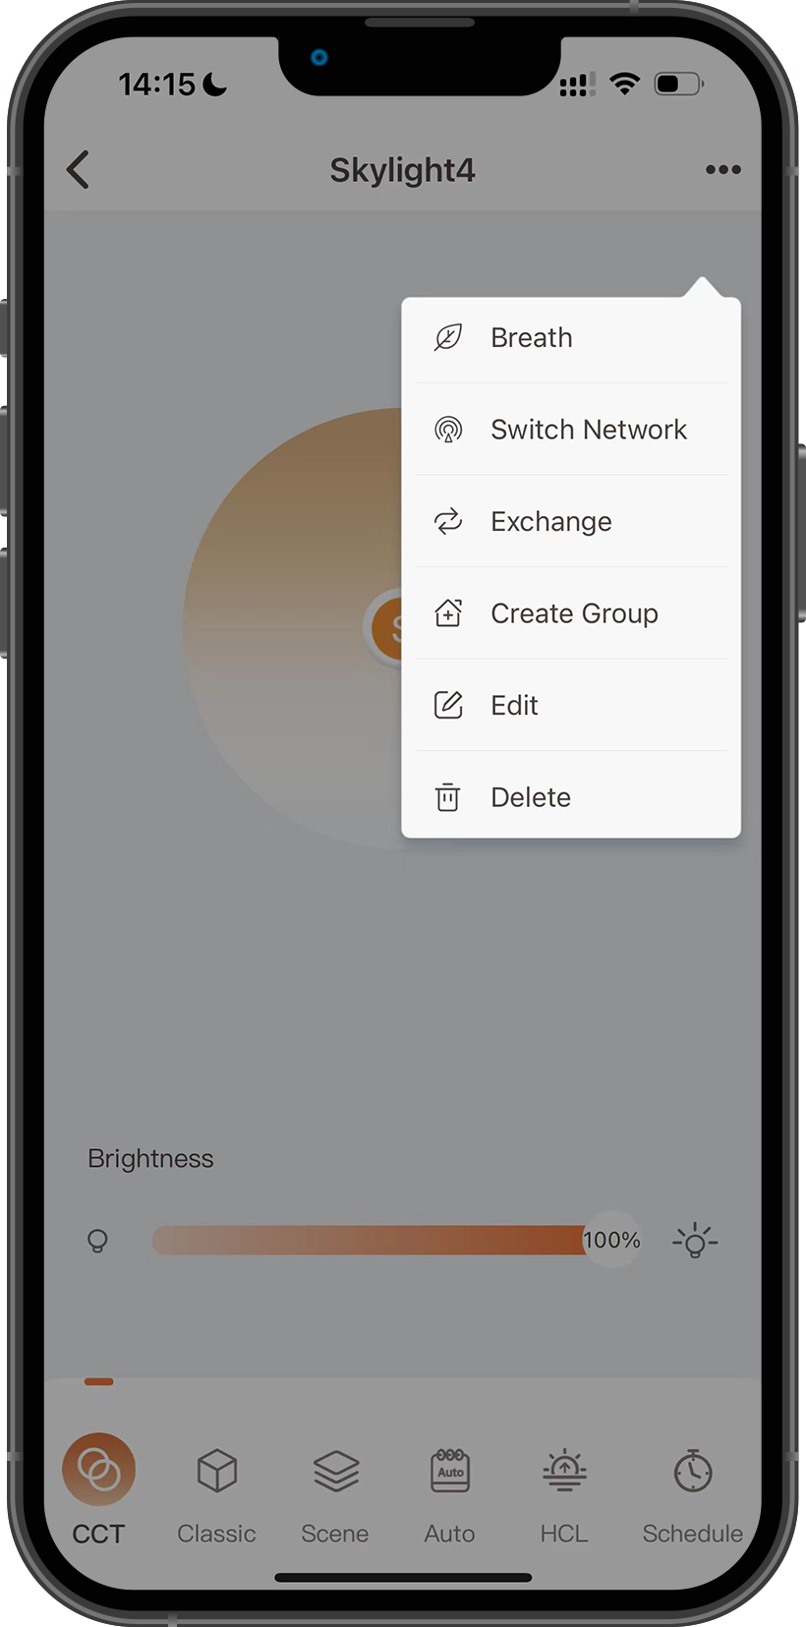
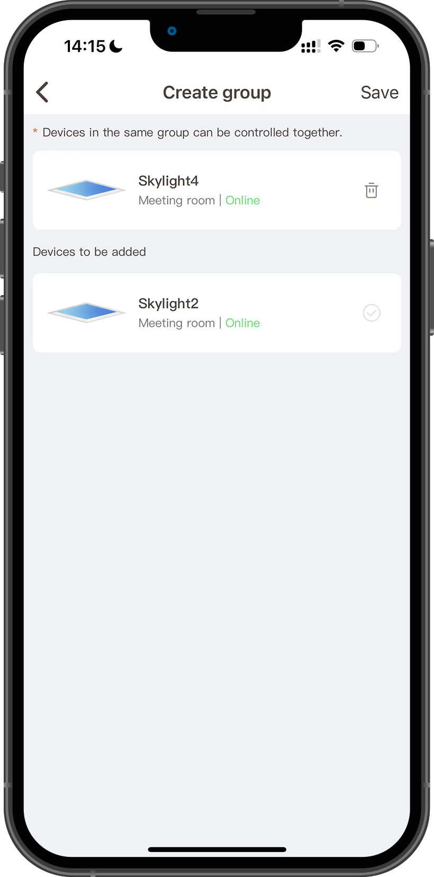
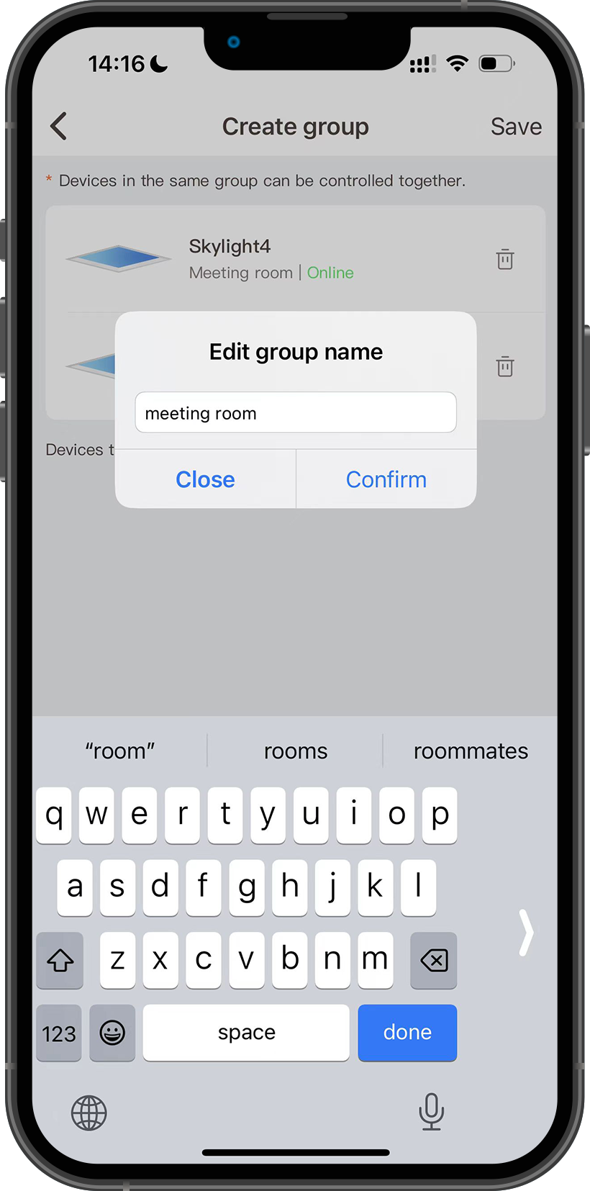
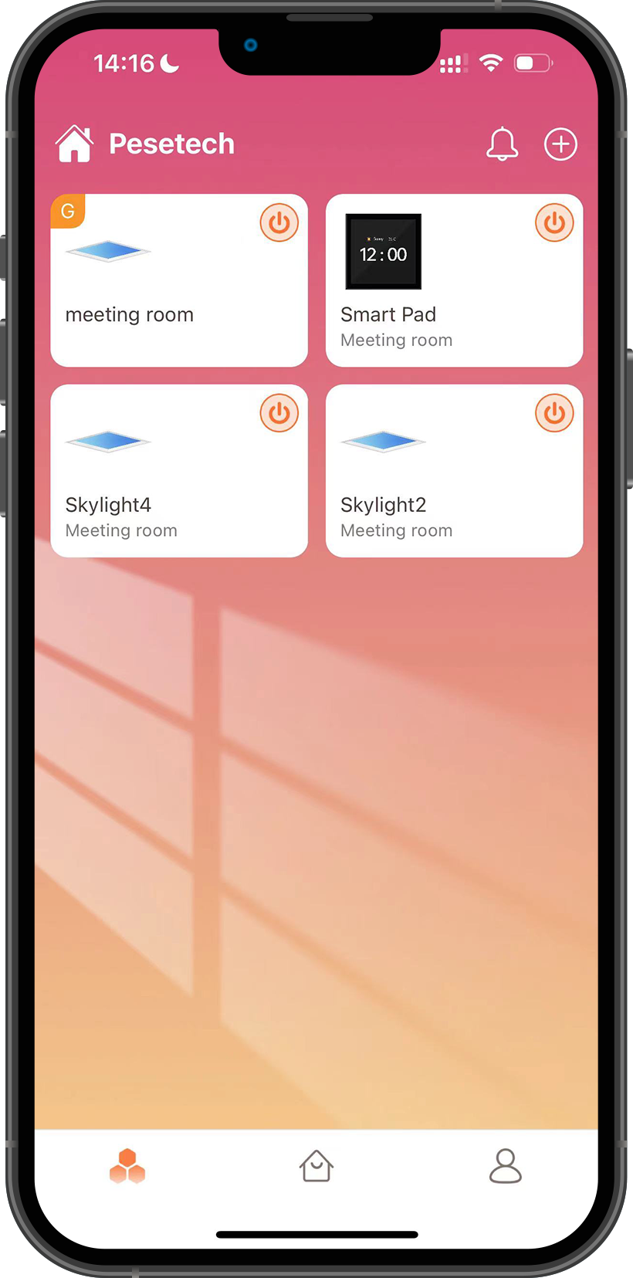
Add Skylight
How Skylight Creates Groups
1
2
3
4
*At least two Skylights are required to create a group, and this demonstration uses 2 Skylights.
*There will be a G character in the upper left corner of the Skylight group.

Slide 13
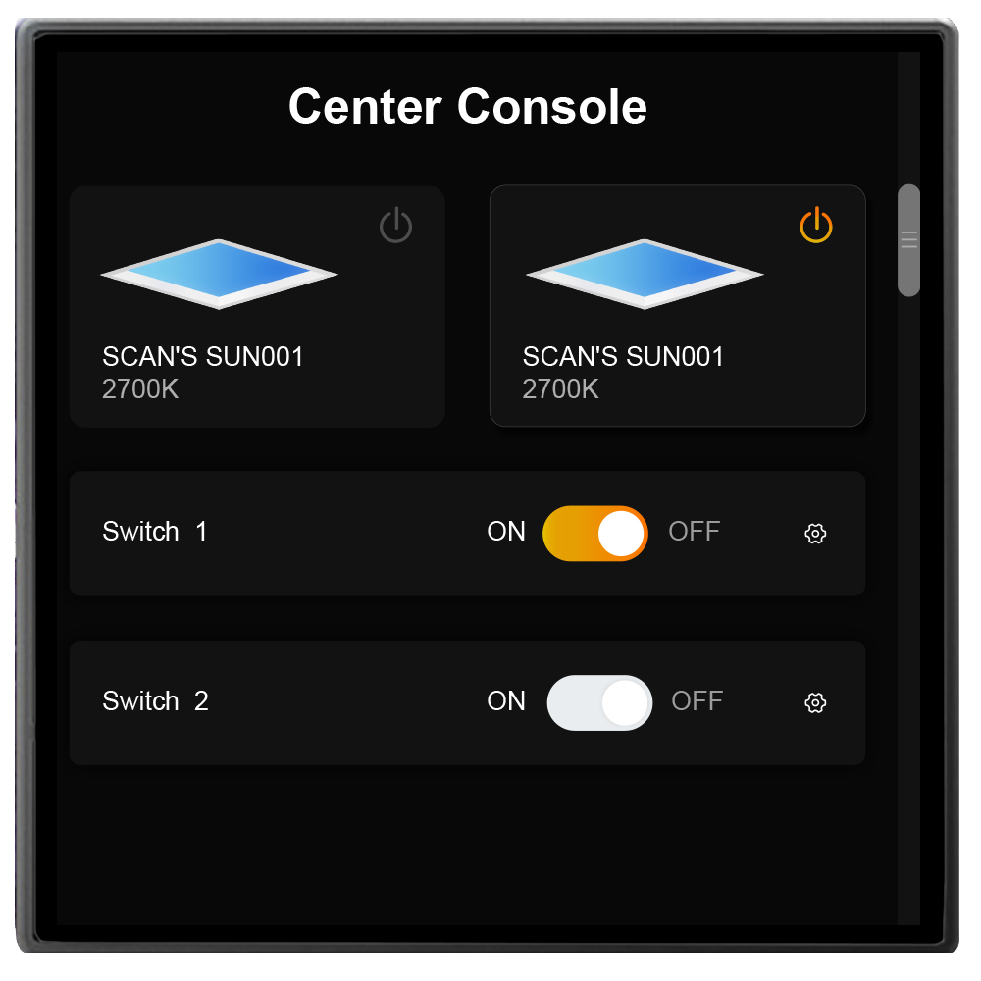
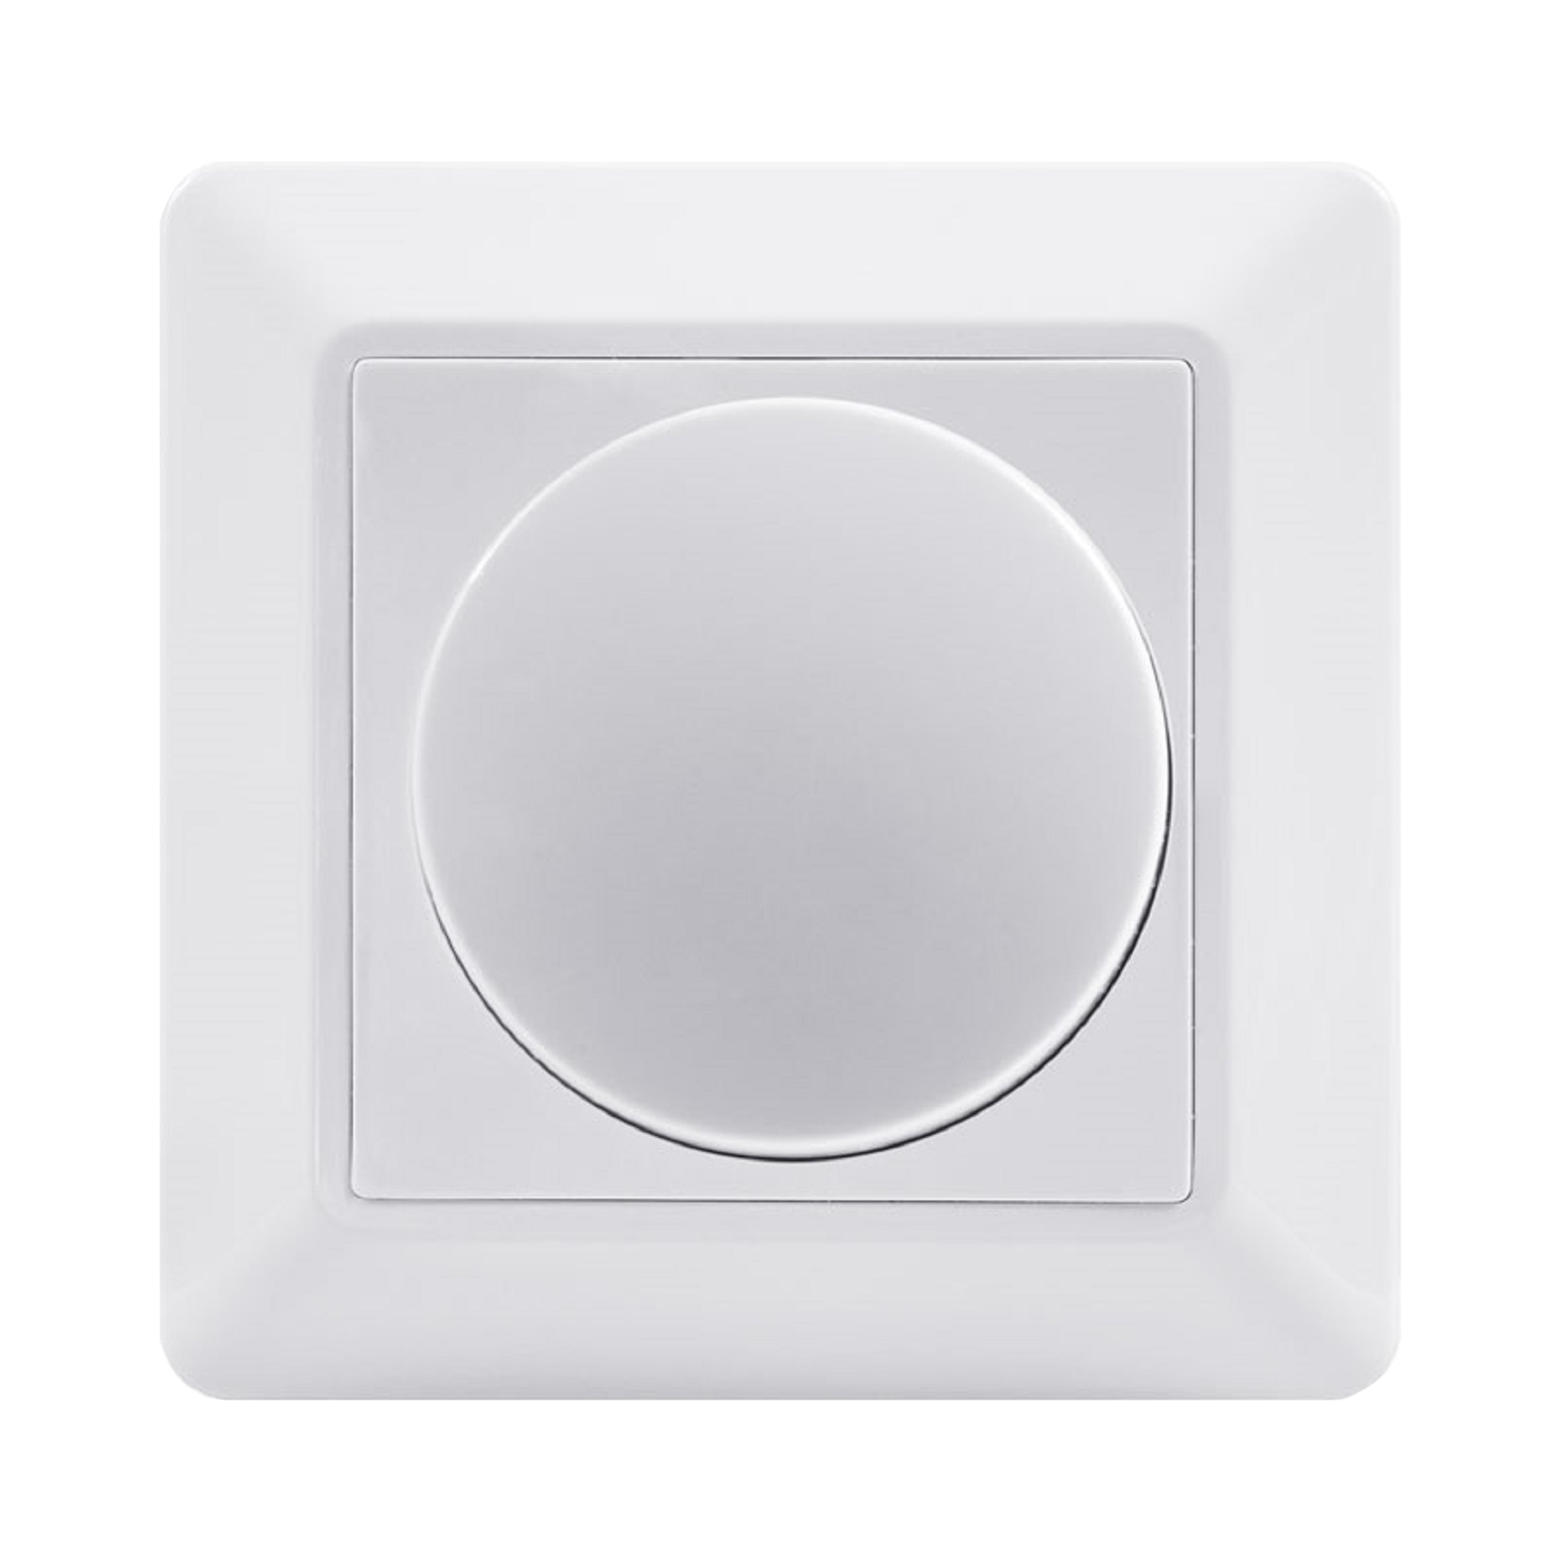
PART THREE
LO
GO
Bind Dimmer
请输入公司名称
The company name

Slide 14
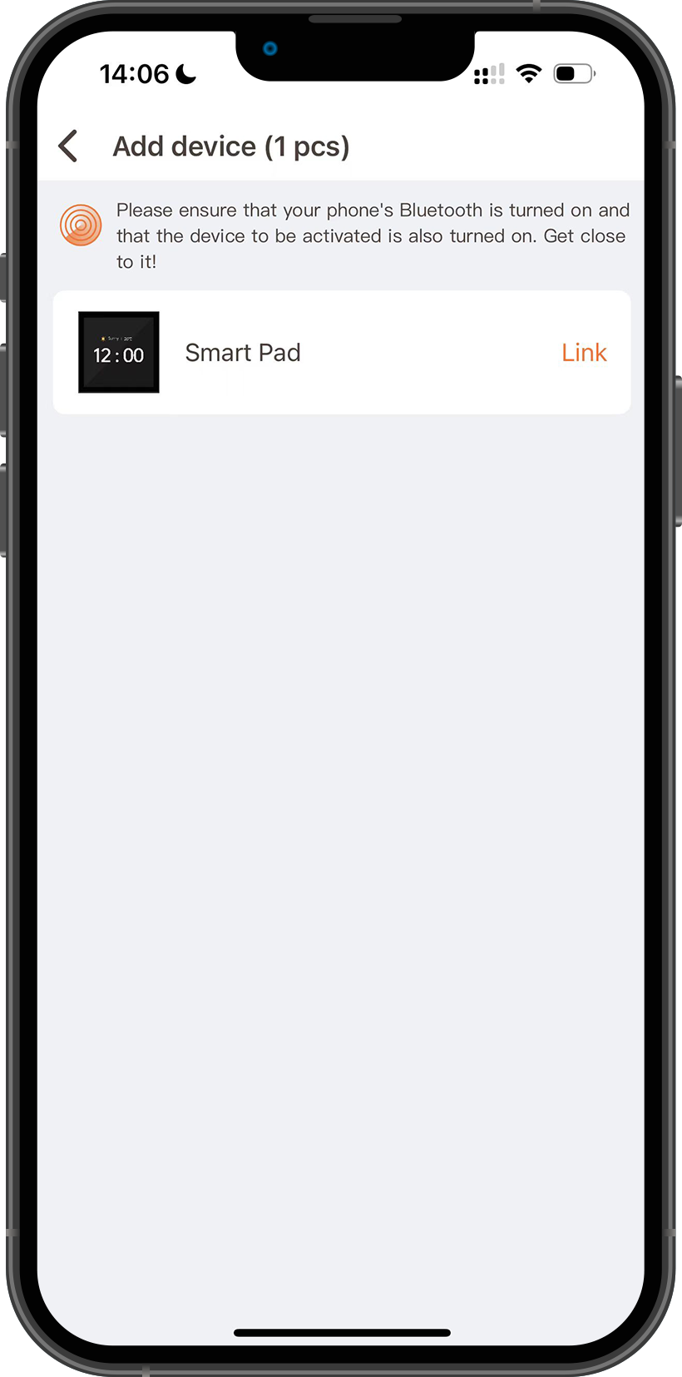
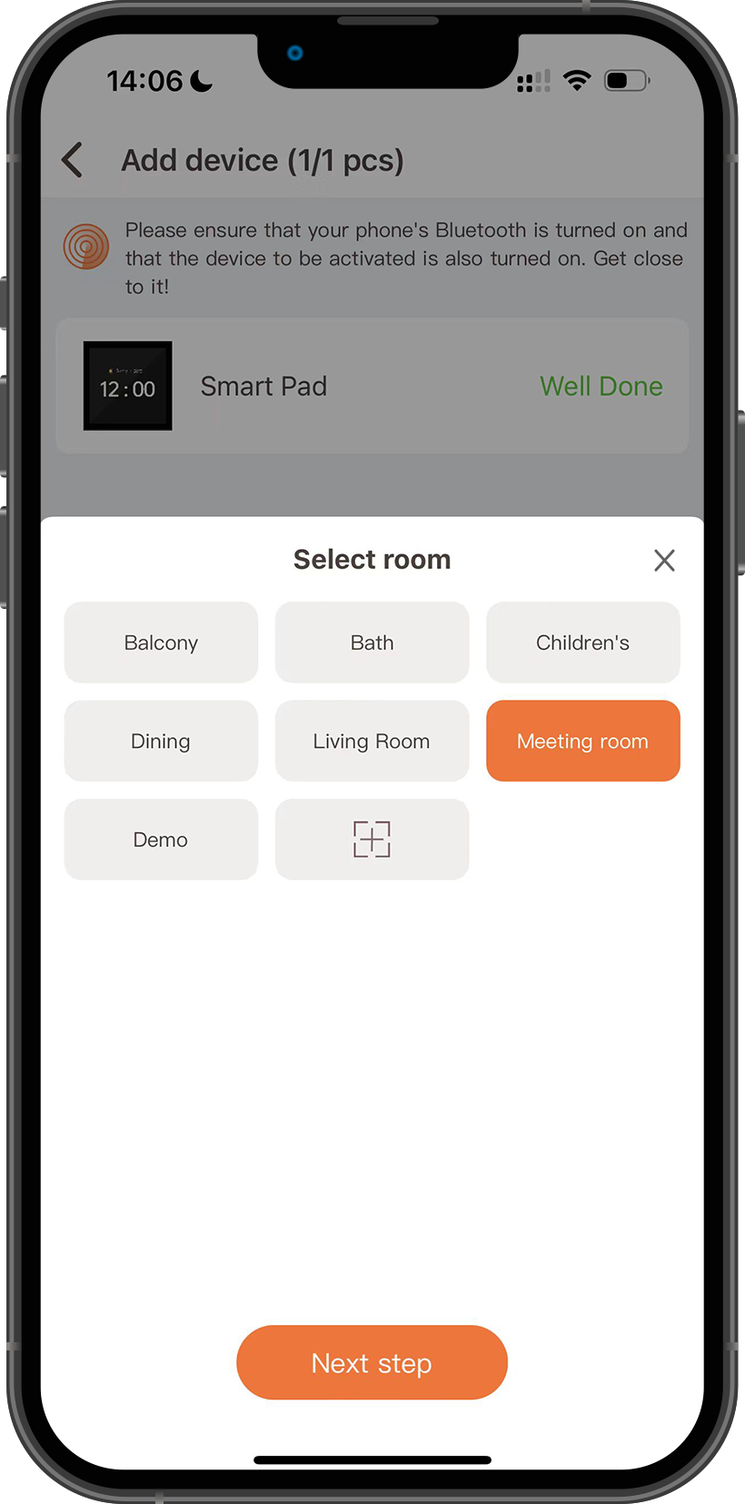
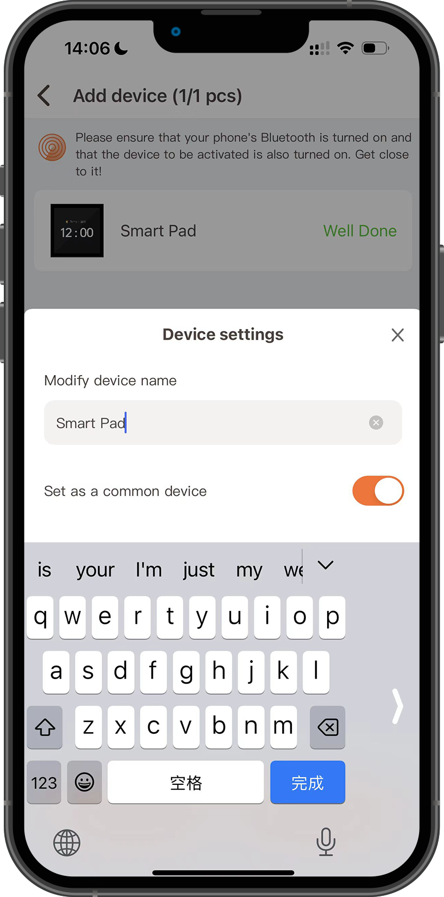
Bind dimmer
Add Smart pad
1
Smart Pad
3
2

Slide 15
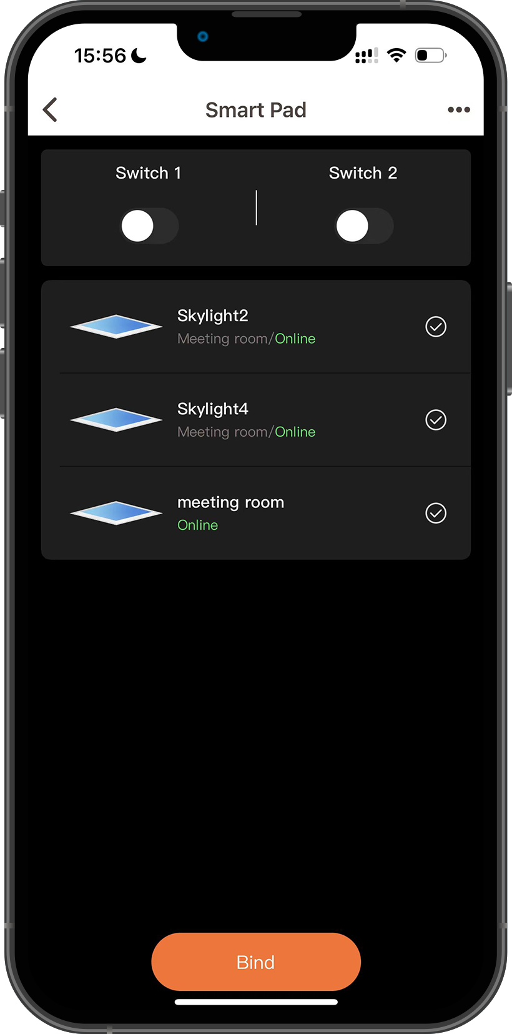
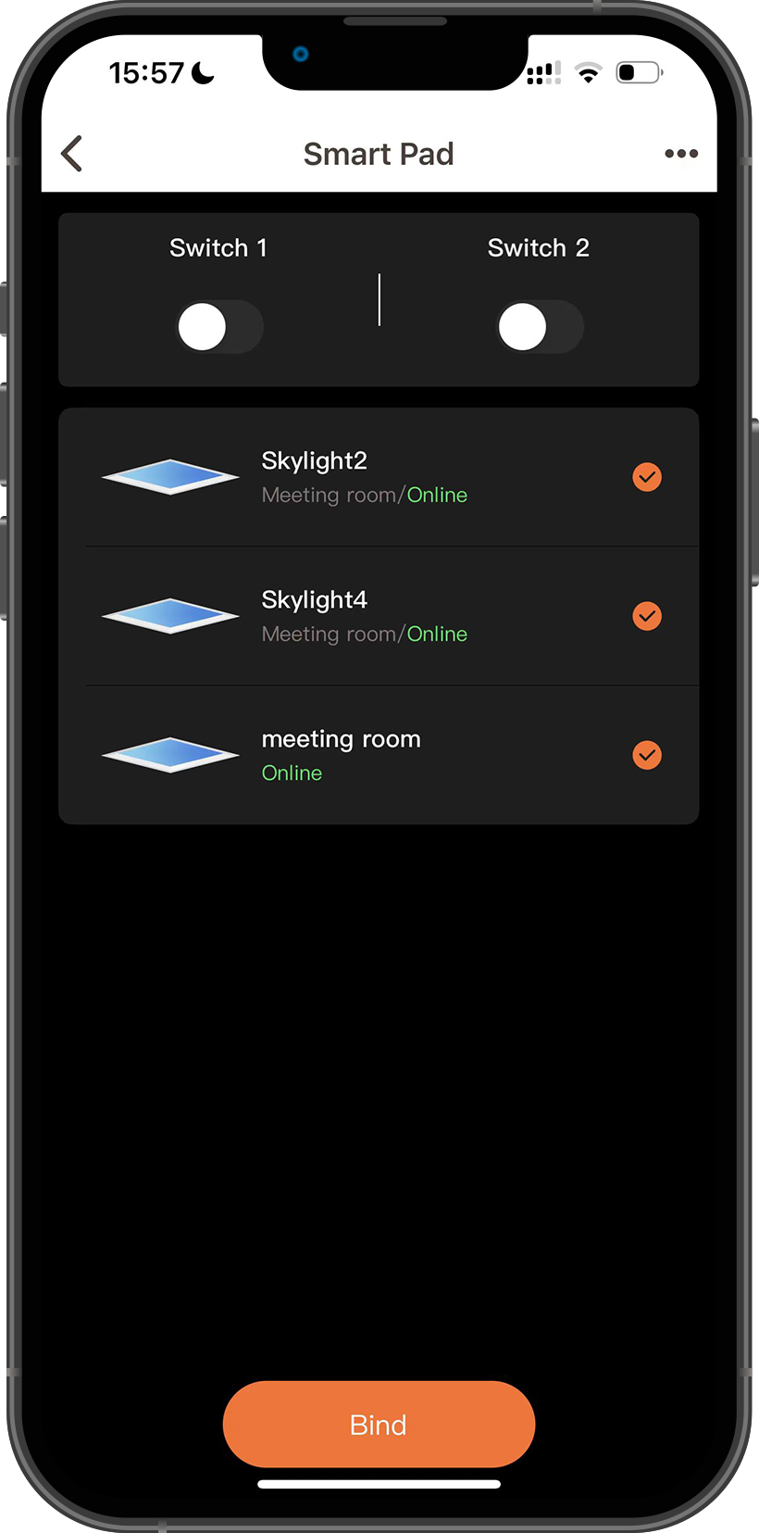
Bind dimmer
Bind Skylight
1
2
Smart Pad
Click the Smart pad icon in the APP to enter the
Smart pad control page.
Select the Skylight you want to bind to the Smart pad, and click Bind.
*Smart pad can be bound to a single Skylight or a group of Skylights.

Slide 16
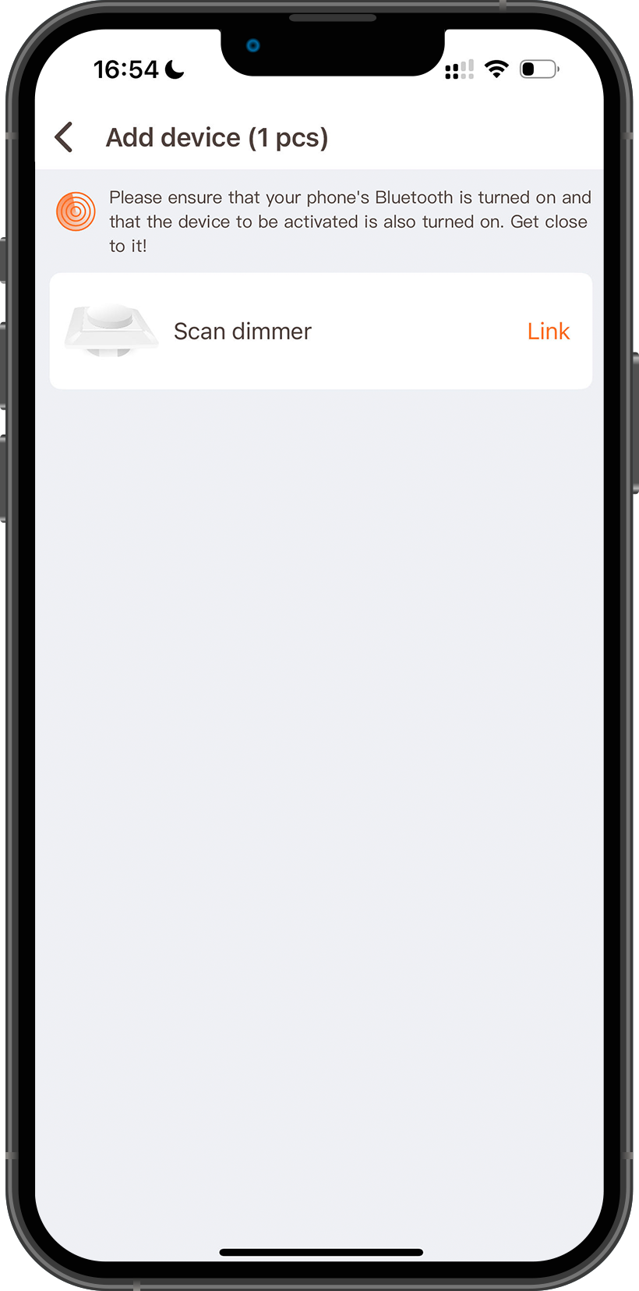
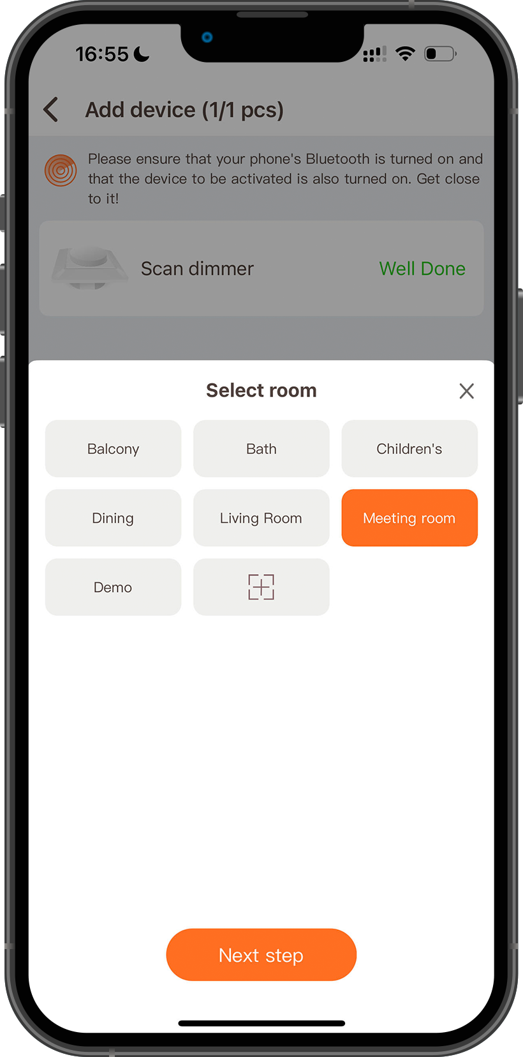
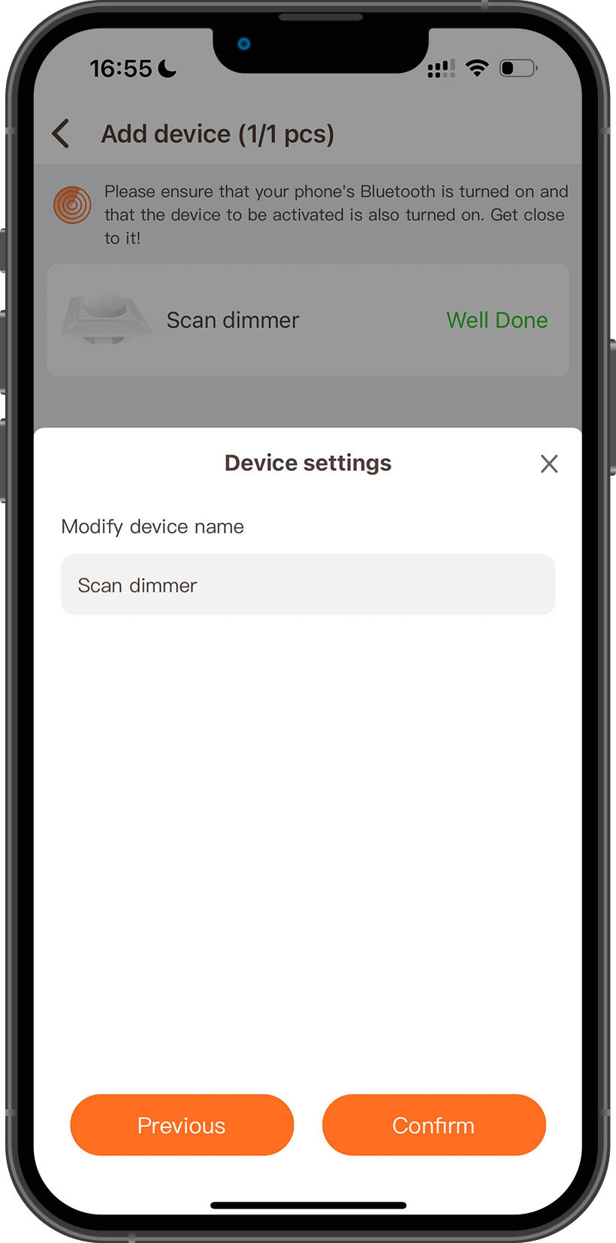
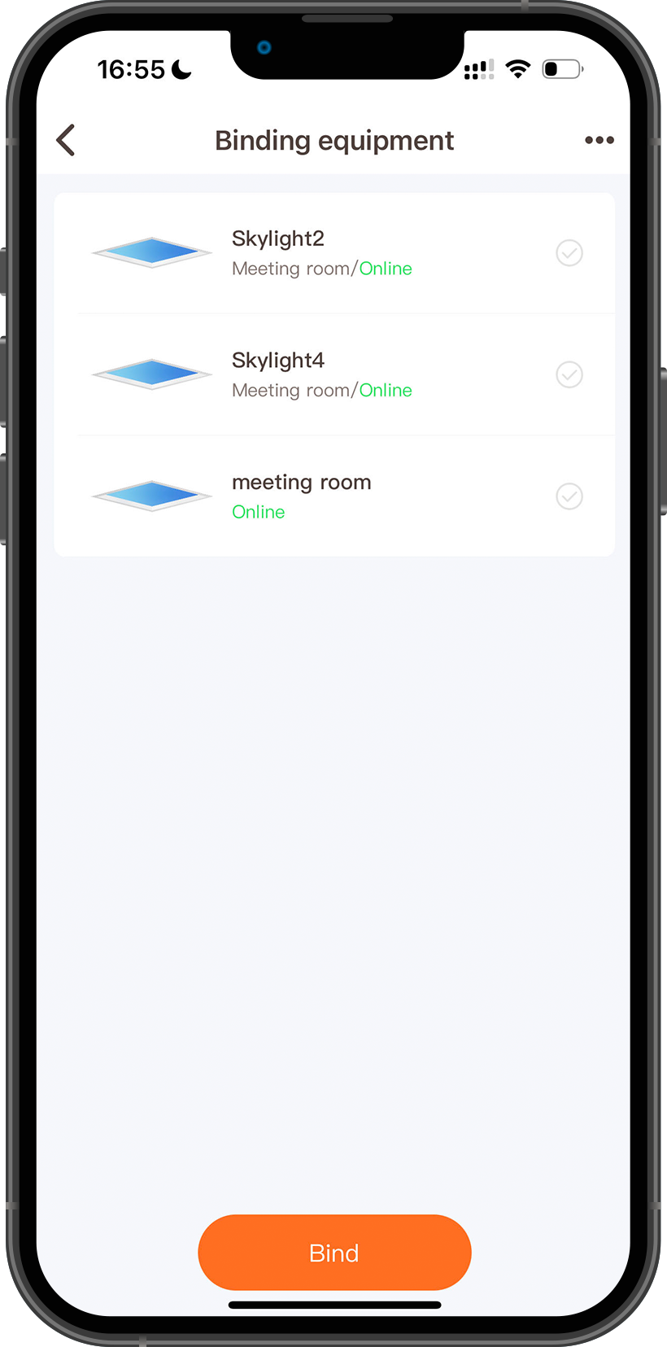
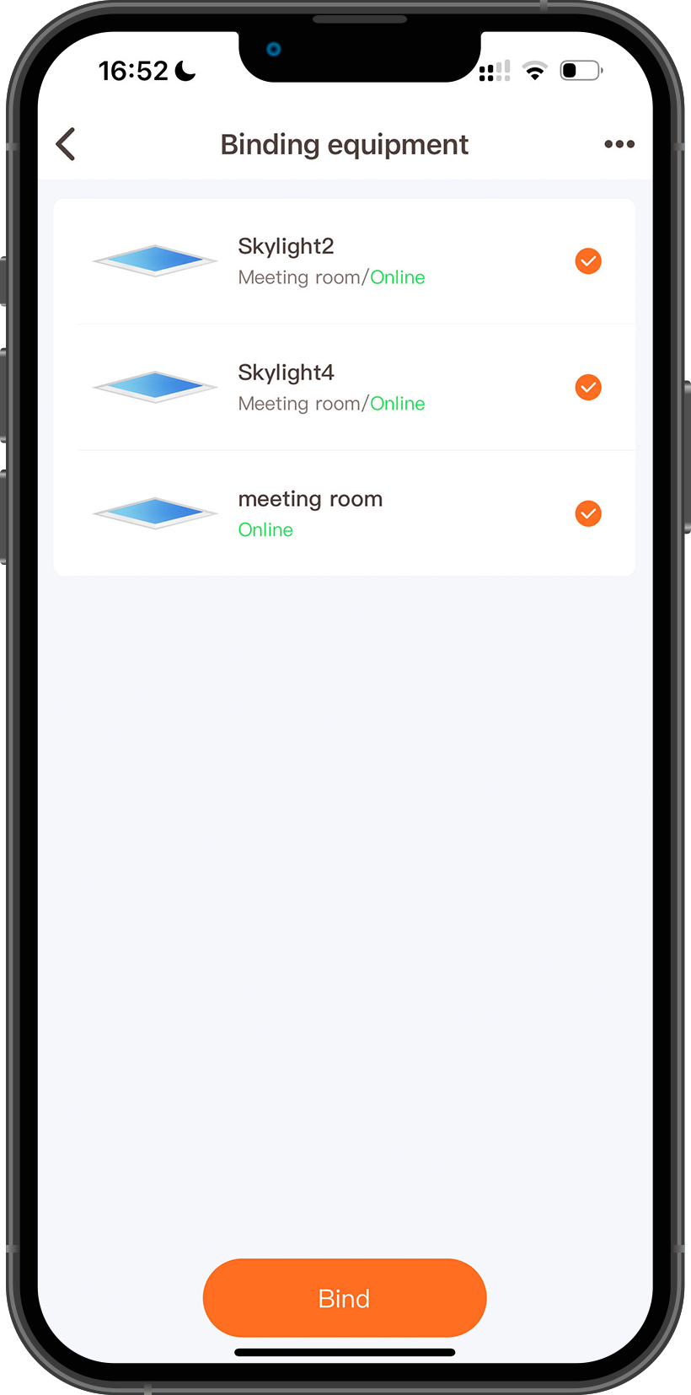
Bind dimmer
Add Scan dimmer and bind Skylight
1
4
Scan dimmer
3
2
5
*1 Scan dimmer can bind up to 128 Skylights. You can choose a single Skylight or a Skylight group.

Slide 17
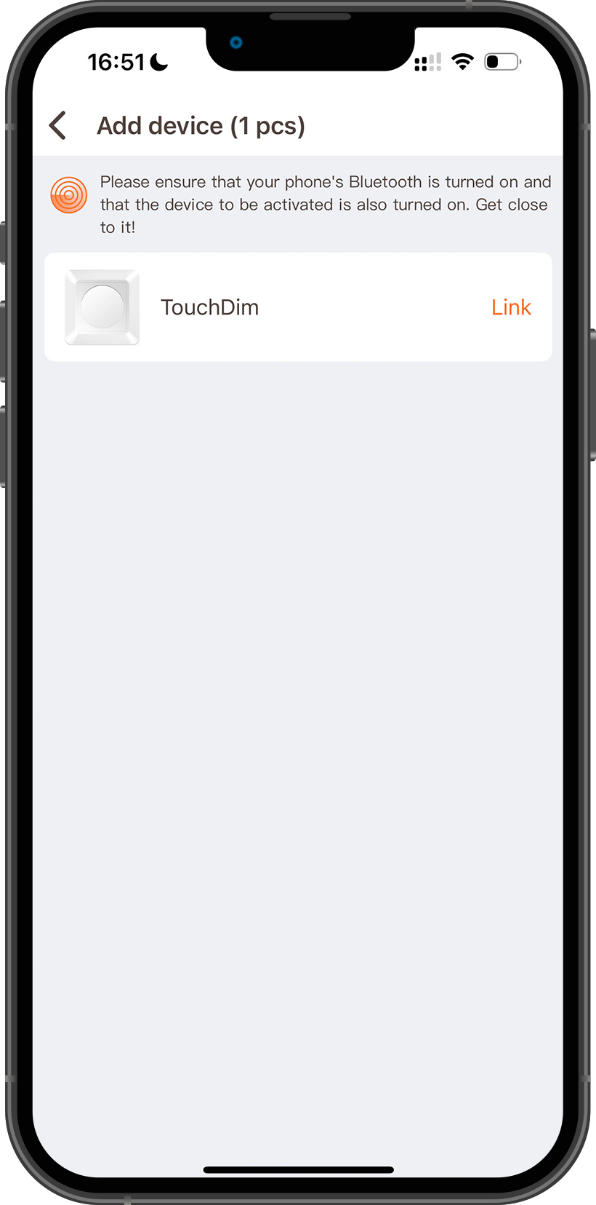
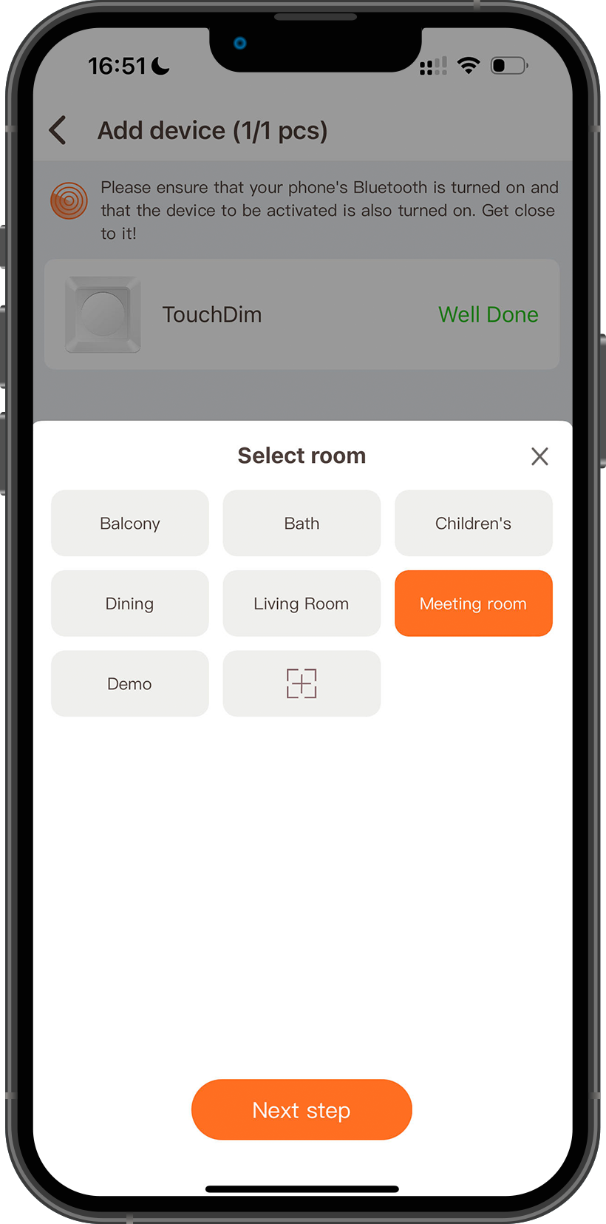
Bind dimmer
Add Scan dimmer and bind Skylight
1
4
Touch dimmer
3
2
5
*1 Touch dimmer can bind up to 128 Skylights. You can choose a single Skylight or a Skylight group.

Slide 18
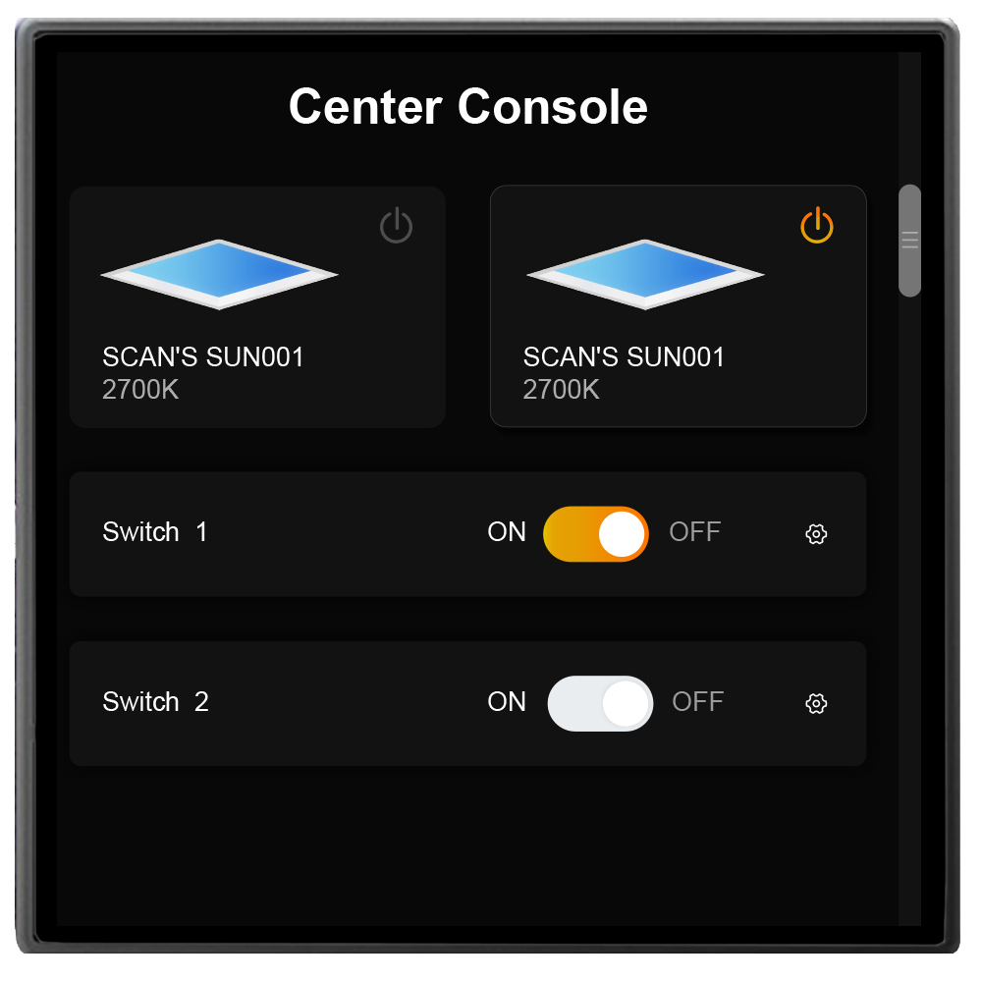
Bind dimmer
How to reset Dimmer
Scan dimmer
Remove the knob of the dimmer, press and hold the reset button for 6 seconds, and the indicator light in the lower left corner will flash red, indicating that the dimmer has been reset successfully.
Touch dimmer
Press and hold the switch button for 10 seconds, and the indicator light of the switch button will flash red and green, indicating that the reset is successful.
Smart pad
Find the reset panel in the settings page of the smart pad.

Slide 19
PART FOUR
LO
GO
Product Features
请输入公司名称
The company name

Slide 20
Product Features
01
CCT
Adjust the color temperature and brightness of Skylight.
02
Classic
9 commonly used color temperature values.
03
Scence
8 scenes, from sunrise to night sky.
read more
04
Auto
Two automation functions, Dawn Fluctuation and Phased OFF.
05
HCL
Automatically simulates changes in the sky throughout the day.
06
Schedule
Set the Skylight to turn on or turn off the light at regular intervals.
read more
read more

Slide 21
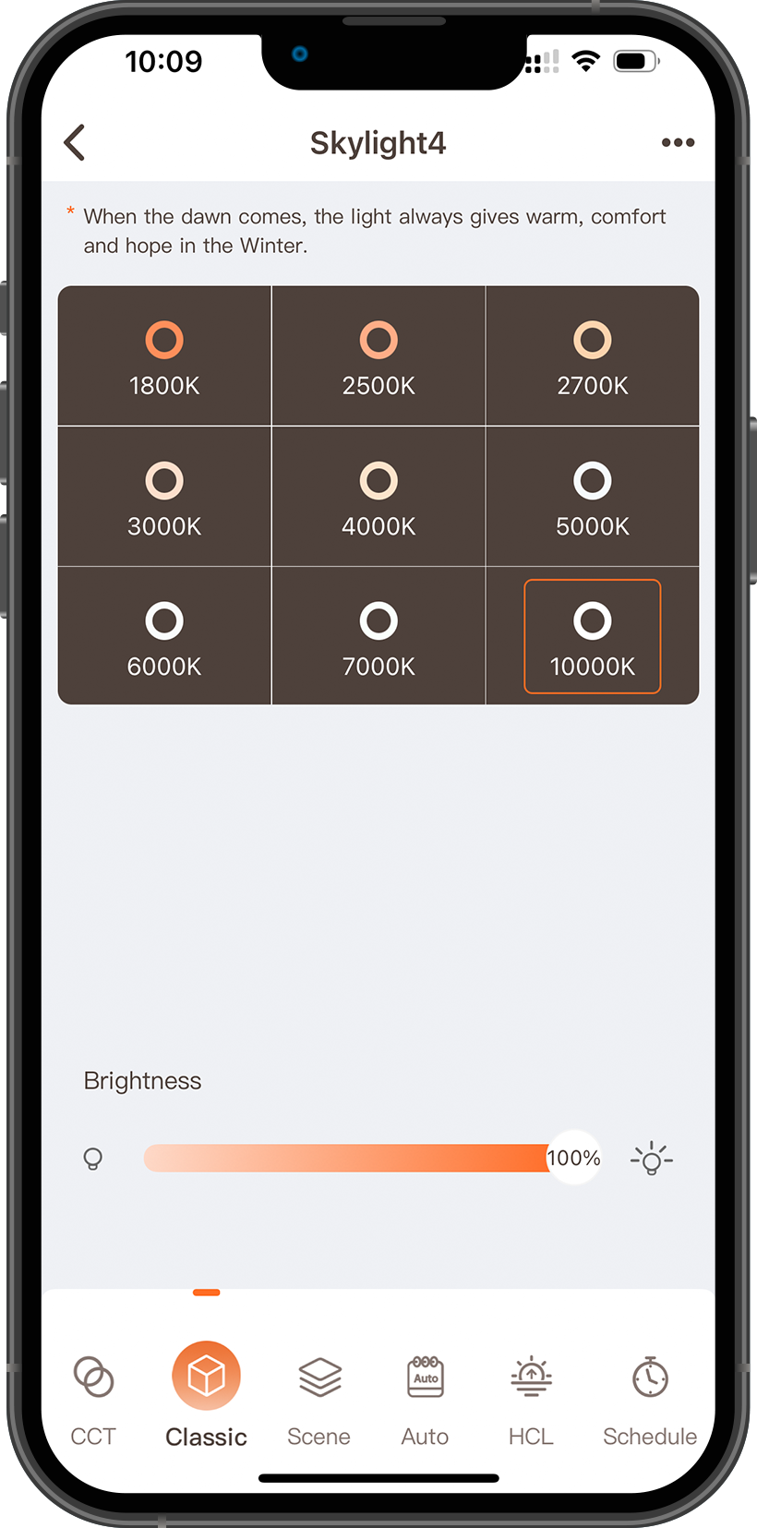
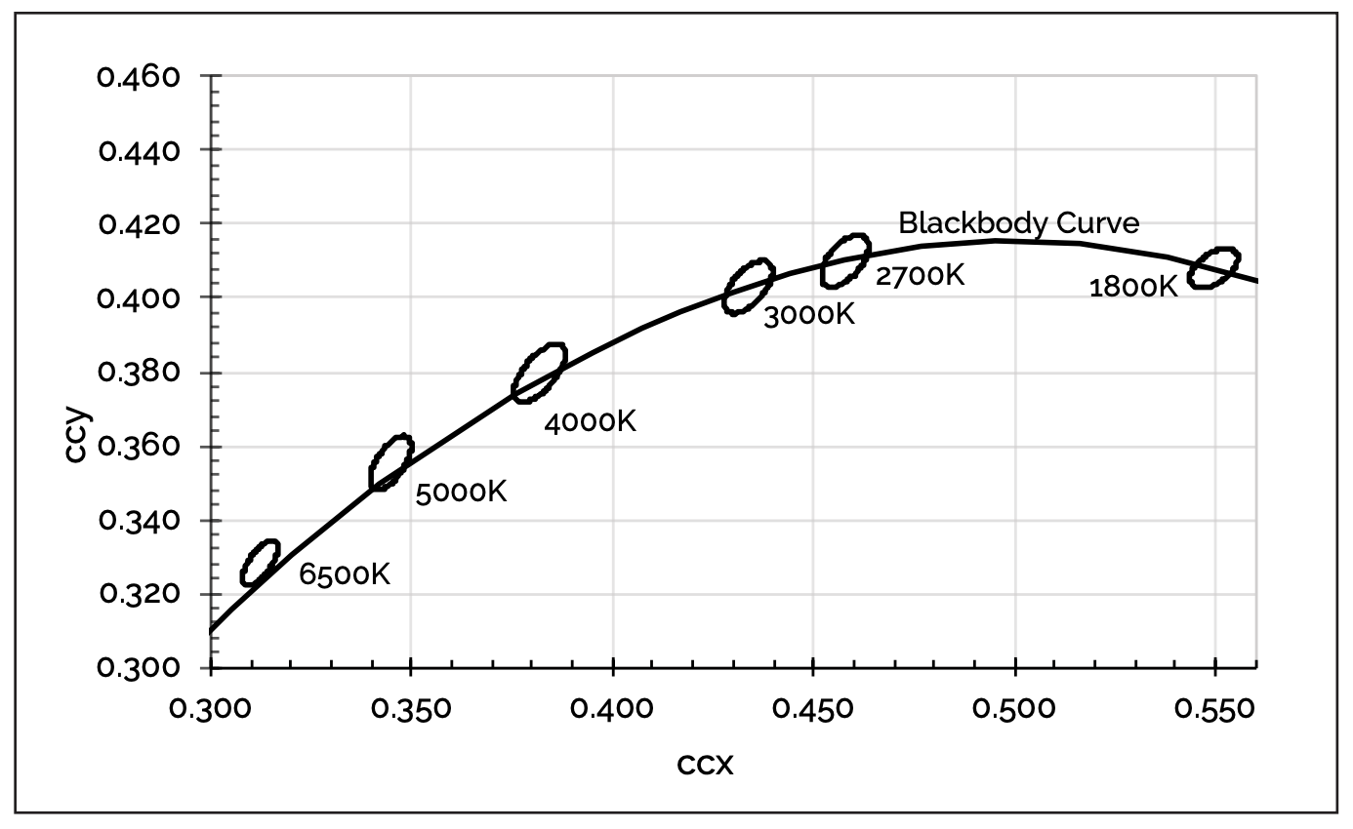
Product Features
Classic
The 9 color temperatures in the Classic page are commonly used color temperature values in daily life. These 9 color temperature values are all calibrated by chromaticity coordinates. Make its coordinates close to the black body curve, the light is more natural and real like sunlight at the same color temperature.

Slide 22
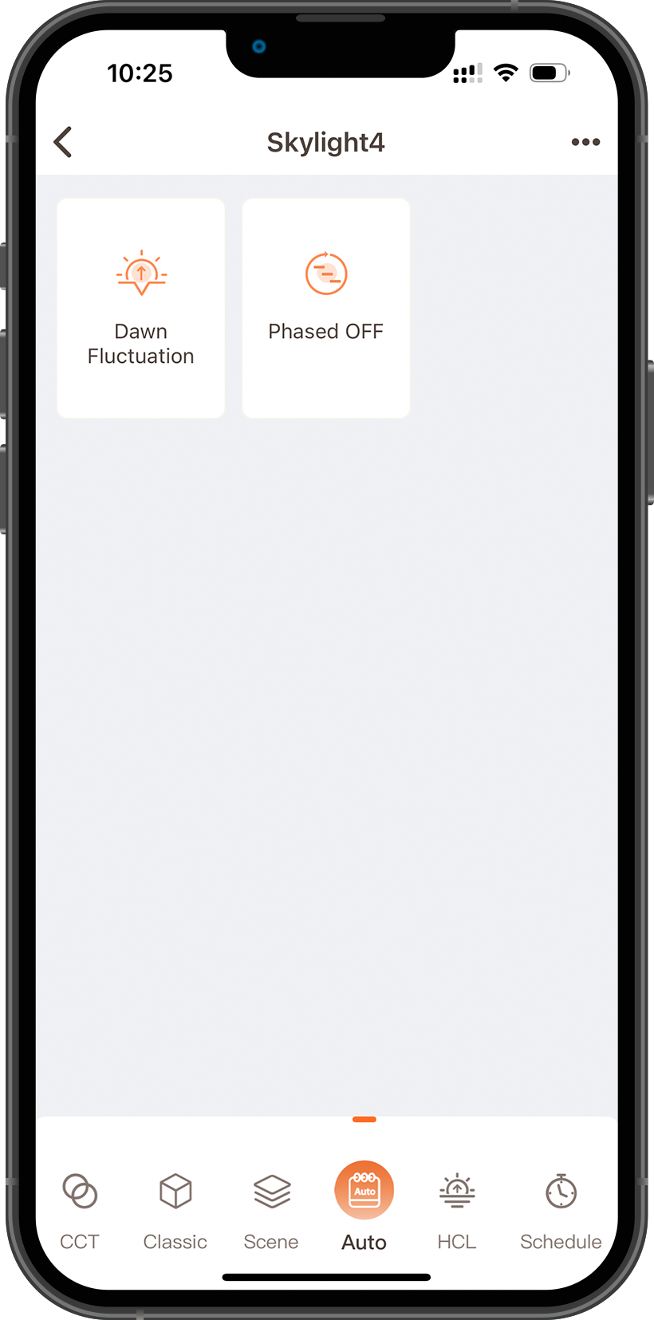
Product Features
Auto
01
Dawn Fluctuation:
This feature is also called wake-up mode, which simulates changes in daylight color temperature.
read more
02
Phased OFF:
This function is developed for children, compared with ordinary timed off, it will gradually reduce the brightness of Skylight in stages to avoid children's safety hazards caused by timed off lights.
read more

Slide 23
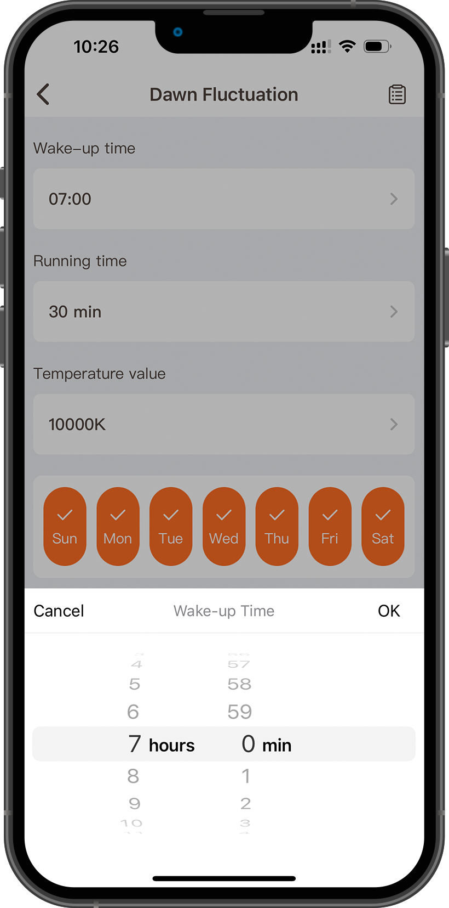
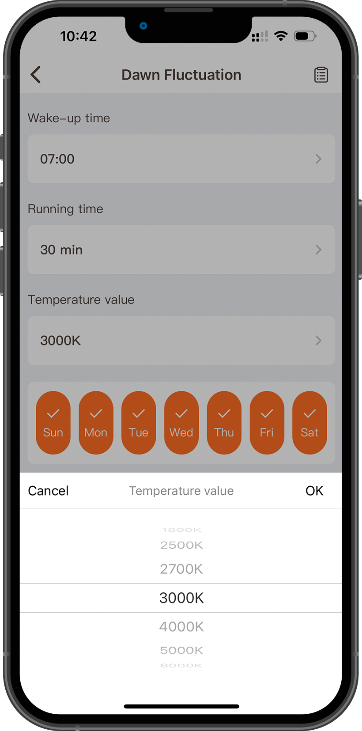
Product Features
1
Dawn Fluctuation
01
Set Time:
This time is the time you want to wake up. After setting, Skylight will start running 30 minutes earlier.
2
02
Set Temperature:
After setting the color temperature, Skylight will change from 1800K to the color temperature value you choose, and the change process lasts for 30 minutes.
*For example, if you want to get up at 7 am, you can set the time at 7 am. Skylight will automatically turn on the light at 6:30 in the morning half an hour in advance, and gradually increase the brightness from 2% to 100%

Slide 24
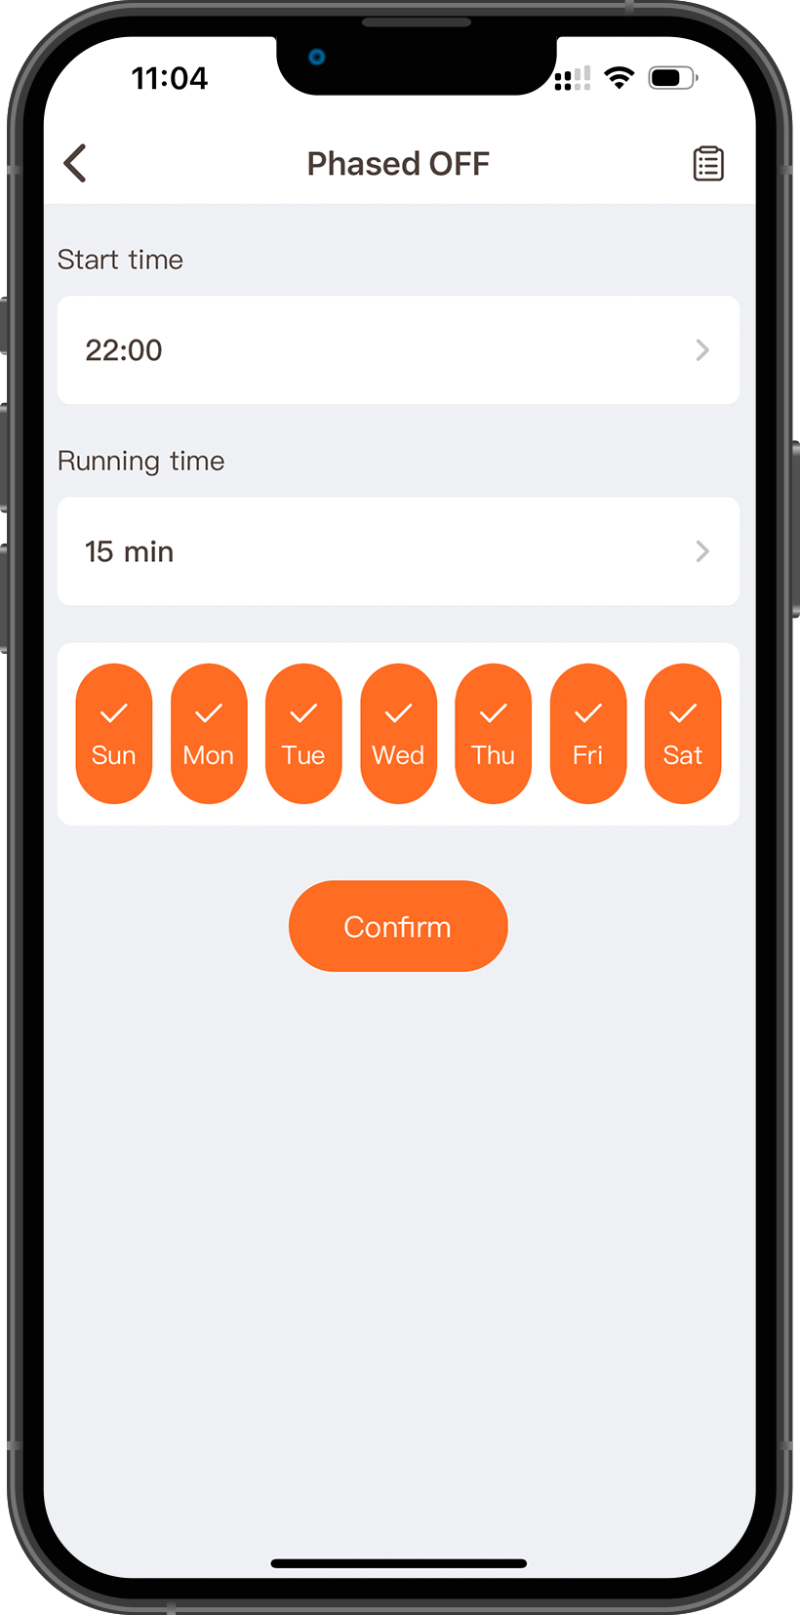
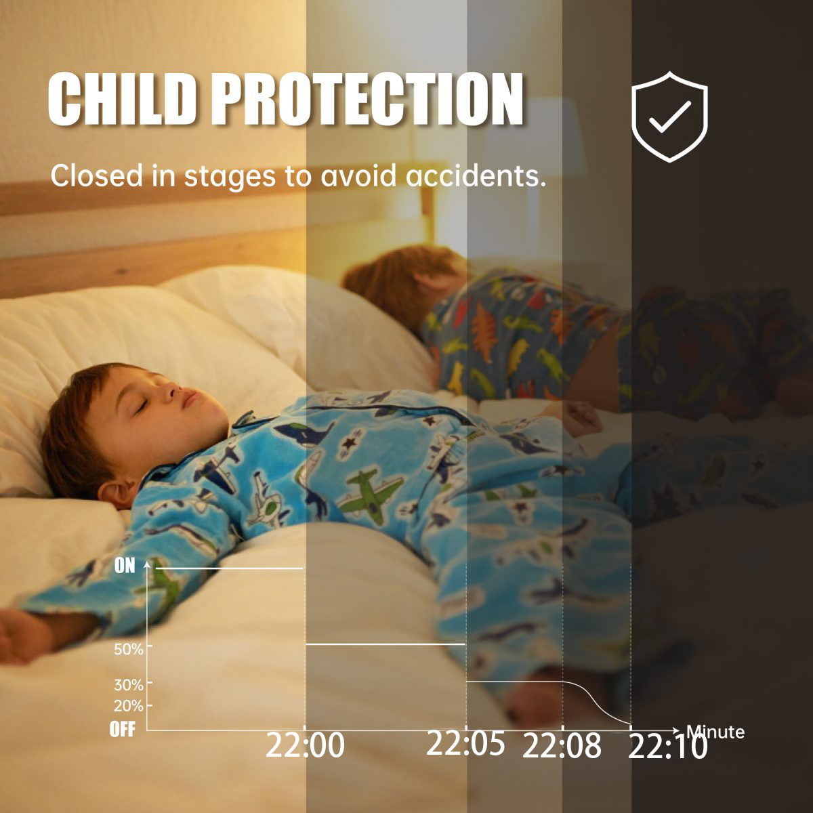
Product Features
1
Phased OFF
2
01
Set Start Time:
Sets the time for program execution for Skylight.
02
Set Running Time:
Sets how long Skylight will reduce brightness in stages.
*For example, if you set the lights to turn off at 10:00 p.m., the brightness of Skylight will be reduced to 50% at 10:00 p.m., then reduced to 30% at 10:05, and reduced to 20% at 10:08, and then slowly turn off Skylight .

Slide 25
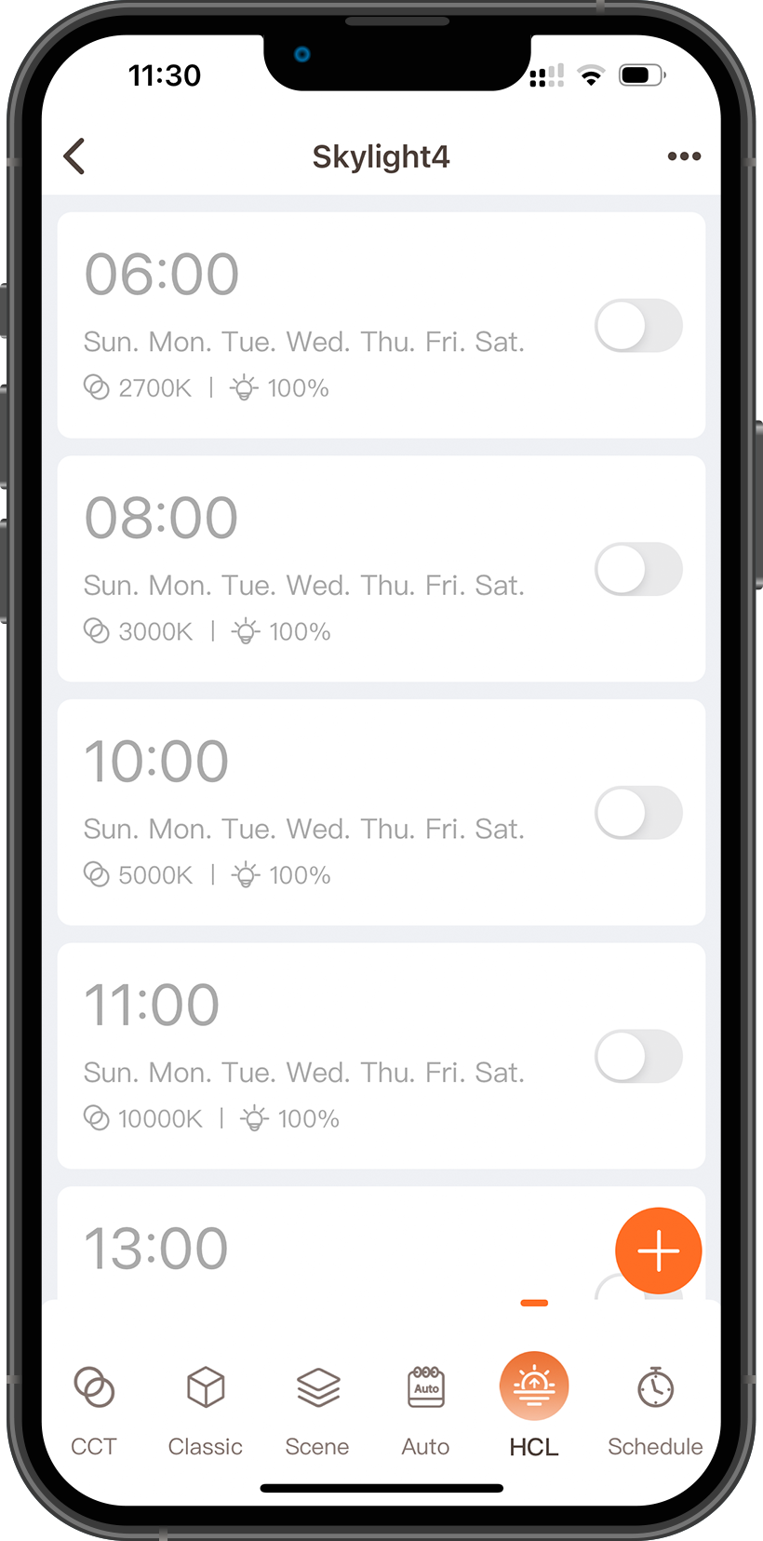
Product Features
HCL(Human-Centric Lighting)
Setting different color temperature and brightness for each time period like setting an alarm clock can simulate the color temperature change of the sky throughout the day.
*For example, if you set the lights to turn off at 10:00 p.m., the brightness of Skylight will be reduced to 50% at 10:00 p.m., then reduced to 30% at 10:05, and reduced to 20% at 10:08, and then slowly turn off Skylight .

Slide 26
Pesetech
Dojoyous photon
Thanks for watching

